Slide 1

Machine Learning for Biomedical Engineering Applications
Week 3
Maral Aminpour, Ph.D.Professor Department of Biomedical Engineering

Slide 2
Regression

Slide 3
Learning objectives
Part 1-2: Multivariate linear regression
Mathematical formulation of multivariate linear regression
Fitting using normal equation and gradient descent
Evaluating performance and overfitting
Part 3: Penalised linear regression
Preventing overfitting using regularisation
Ridge and Lasso regression
Part 4: Non-linear regression
Non-linear feature transformation
Kernel trick
Notes:
The lecture is split into four parts. In the first two parts we will talk about Multivariate linear regression, including mathematical formulation, fitting and evaluation.
In the third part we will show how penalised regression models can prevent overfitting.
In the final part we will discuss non-linear regression and introduce the kernel trick.

Slide 4
Part I: Multivariate Linear Regression
Mathematical formulation
Normal equation
Notes:
We will start with mathematical formulation and fitting of the linear regression model.

Slide 5
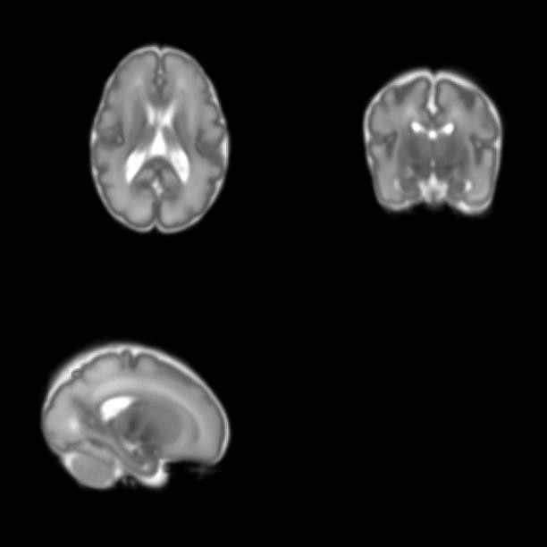
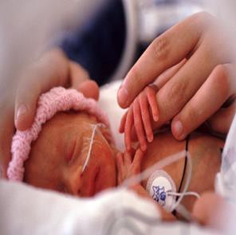
Application: neonatal brain growth
Application: neonatal brain growth
Around the time of birth the brain grows very quickly
Preterm birth alters brain development
Developing preterm brain 29-44 weeks GA

Slide 6
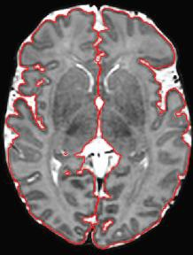
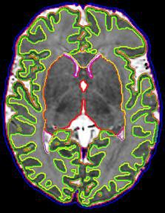
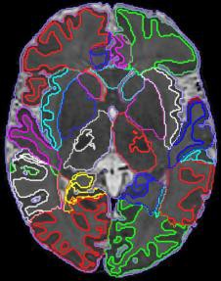
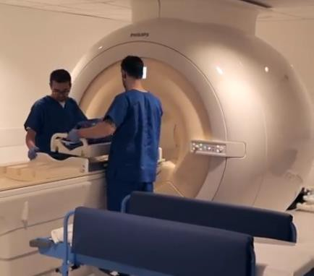
Application: neonatal brain growth
We can acquire brain MRI scans of newborn babies
And perform segmentation to measure volumes of brain structures
Whole brain volume
Six brain tissues
86 brain structures

Slide 7
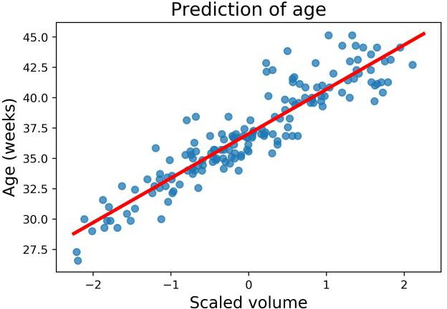
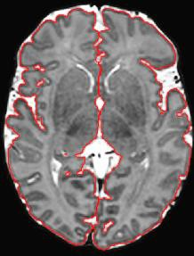
Application: neonatal brain growth
Machine learning task: Predict the age of a baby from volumes of brain structures
Simplest marker of growth: whole brain volume
Each circle is a baby
Feature: brain volume
Target value: age
Linear model suitable
Notes:
The machine learning task is to predict the age of a baby from these measurements. A simplest marker of growth is whole brain volume that we have already used for prediction of the age when we first introduced linear regression. In this plot each circle corresponds to a baby, on the x axis we have the feature, the whole brain volume that has been scaled using standard scaler. The target value is the age of the baby and it is plotted on the y axis. Because we have only one feature, this is a univariate linear regression and the model has only two parameters to fit, slope and intercept. The fitted model is displayed using the red line. We have achieved R2 score
0.85 which is quite high, so the linear model fits this dataset well.

Slide 8

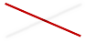
Application: neonatal brain growth
Machine learning task: Predict age of a baby from volumes of brain structures
Prediction using whole brain volume gives 𝑅² = 0.85
We would like close to 1
Which type of error we have?
Bias
− No systematic errors
Variance
− Low complexity (2 params)
Noise
− Yes, but irreducible
Notes:
But is it possible to further increase the performance of this model? In other words, that means increasing R2 score to be closer to 1.
Let’s discuss what type of error we have in this dataset. What do you think, is it mostly bias, variance or noise?
It is not mainly bias, because we cannot see any systematic errors, linear model fits the trend well.
It is also not variance, because this model has very low complexity, with only 2 parameters to fit.
It is therefore mainly noise, however, we cannot decrease noise in the data by choosing a different model.

Slide 9
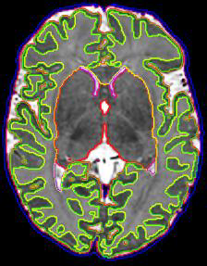

Application: neonatal brain growth
Machine learning task: Predict age of a baby from volumes of brain structures
How can we improve the predictions further?
Increase the number of features => multivariate linear regression
Six brain tissues
86 brain structures
Notes:
We call linear regression multivariate if we have more than one feature. Let’s say that we have volumes of D different brain structures, and we will denote them x_i1, …,x_iD. Each D-dimensional feature vector has a correspoding target value y_i associated with it, which in this application corresponds to the age at scan. Index i corresponds to the samples in the training set, in this case the individual babies, and we have a set of N samples. The prediction model is a linear equation, where w_0 is the intercept, weights w_1 to w_N are the slopes corresponding to different features. The weights are the parameters of the model that we want to find, and y hat is the predicted target value. The model can be fitted by minimising the sum of squared errors between predicted and expected target values.

Slide 10
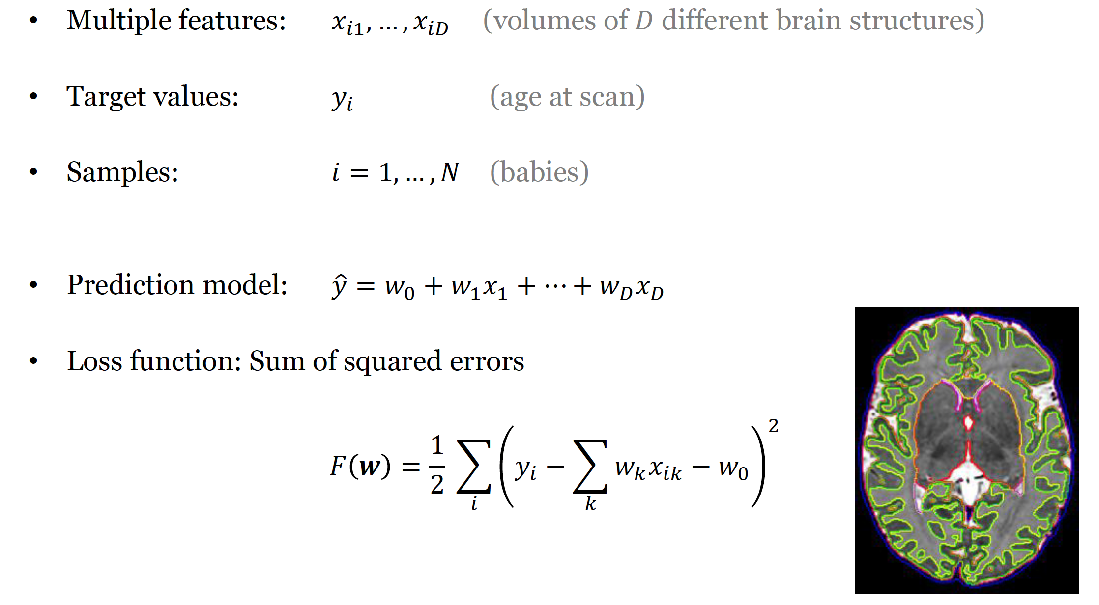
Multivariate linear regression
Notes:
We call linear regression multivariate if we have more than one feature.
Let’s say that we have volumes of D different brain structures, and we will denote them x_i1, …,x_iD. E
each D-dimensional feature vector has a corresponding target value y_i associated with it, which in this application corresponds to the age at scan.
Index i corresponds to the samples in the training set, in this case the individual babies, and we have a set of N samples.
The prediction model is a linear equation, where w_0 is the intercept, weights w_1 to w_N are the slopes corresponding to different features.
The weights are the parameters of the model that we want to find, and y hat is the predicted target value.
The model can be fitted by minimising the sum of squared errors between predicted and expected target values.

Slide 11
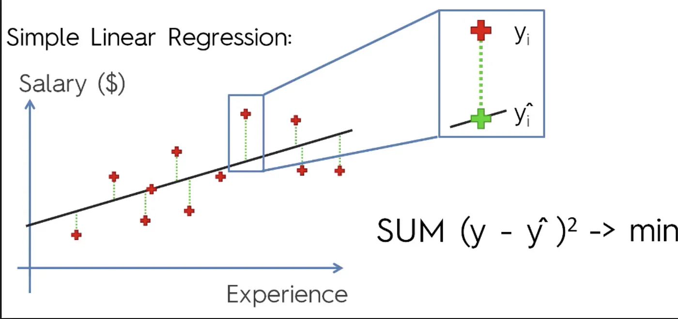
Loss Function (Sum of squared errors)
Target Values
Age
Predicted Values
Volume
The model can be fitted by minimising the sum of squared errors between predicted and expected target values.

Slide 12
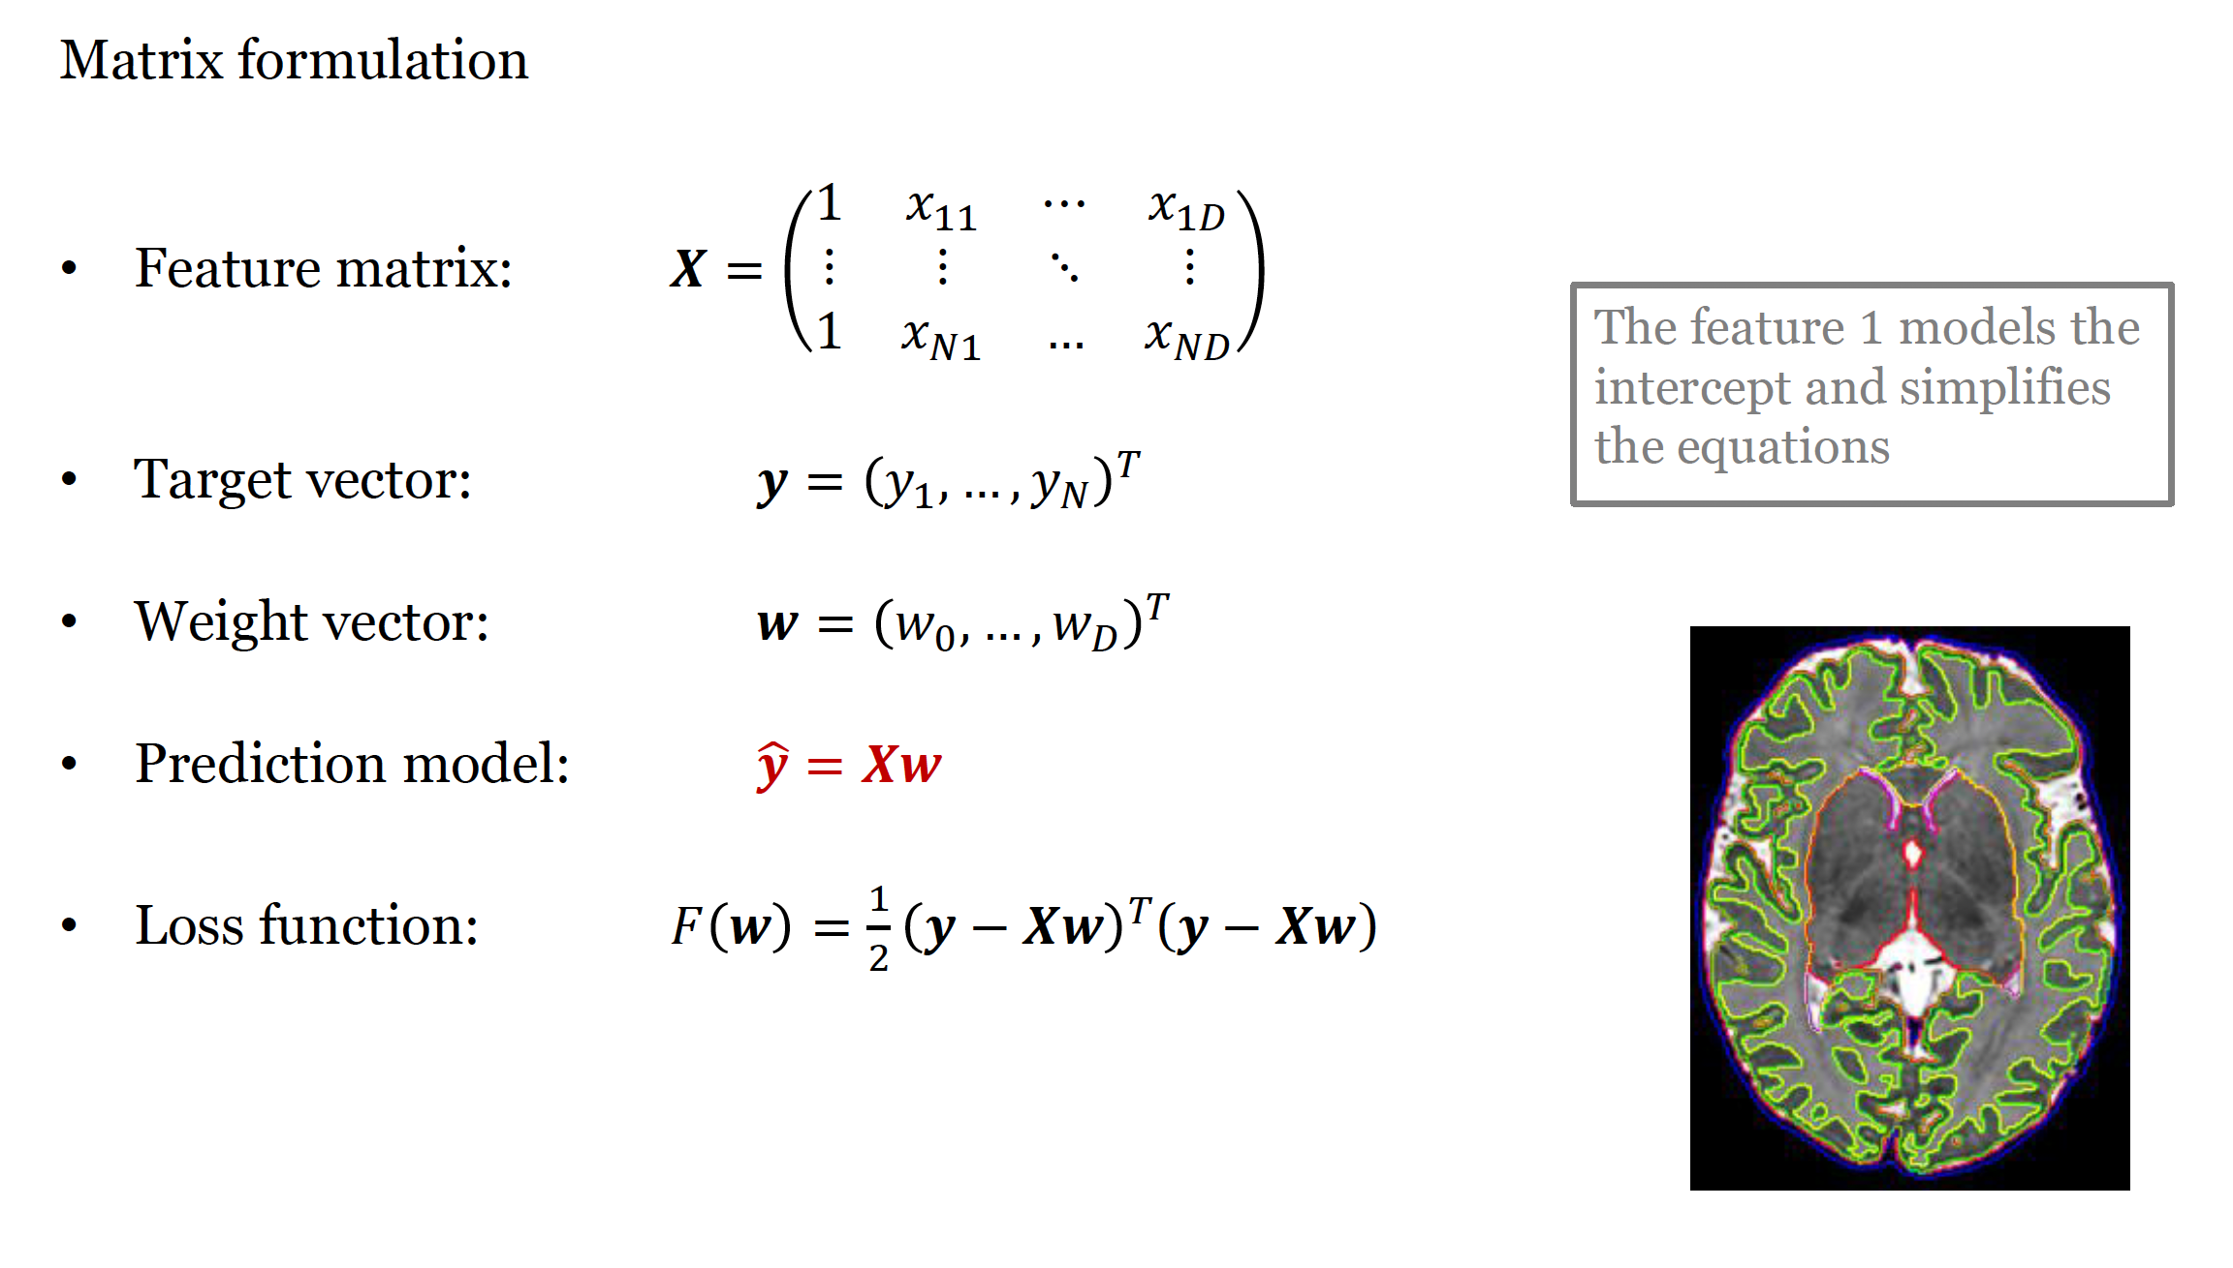
Multivariate linear regression
Notes:
It is also useful to express the linear regression problem using matrix formulation.
We will have a feature matrix with all the samples and features denoted by capital bold X, as before,
but this time we will add an extra column of ones to simplify the equations.
The feature 1 models the intercept and this way we will have the same number of features and parameters w, which is D+1.
We will also denote the target vector by bold y, and the weight vector by bold w. Prediction model then can be expressed by a simple multiplication of a feature matrix by the weight vector. Bold y hat represents the predicted target vector.
The loss function is expressed in matrix formulation as one half of y-Xwtransposed times y-Xw.

Slide 13
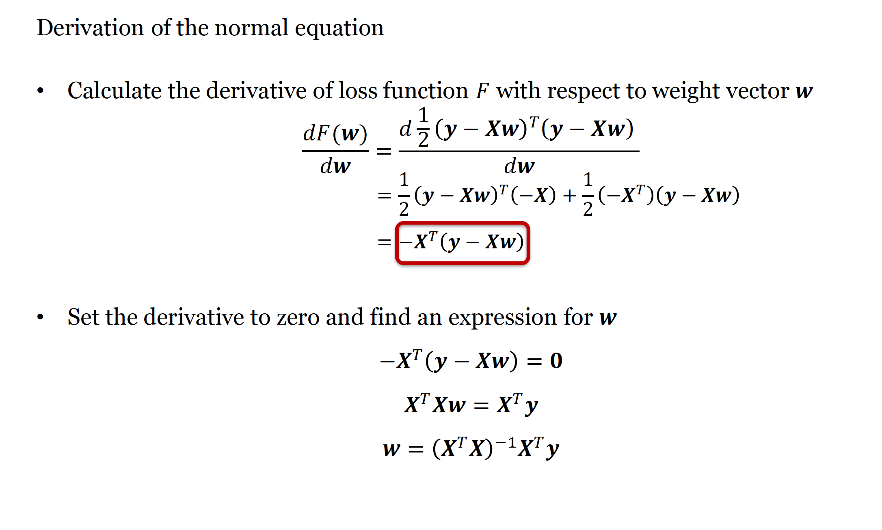
Fit multivariate linear regression model
Notes:
Here we can see detailed derivation of the normal equation. First, we calculate the derivative which is –X transposed times y-Xw. We then set this derivative to zero to find the expression for w, which results in the normal equation.

Slide 14
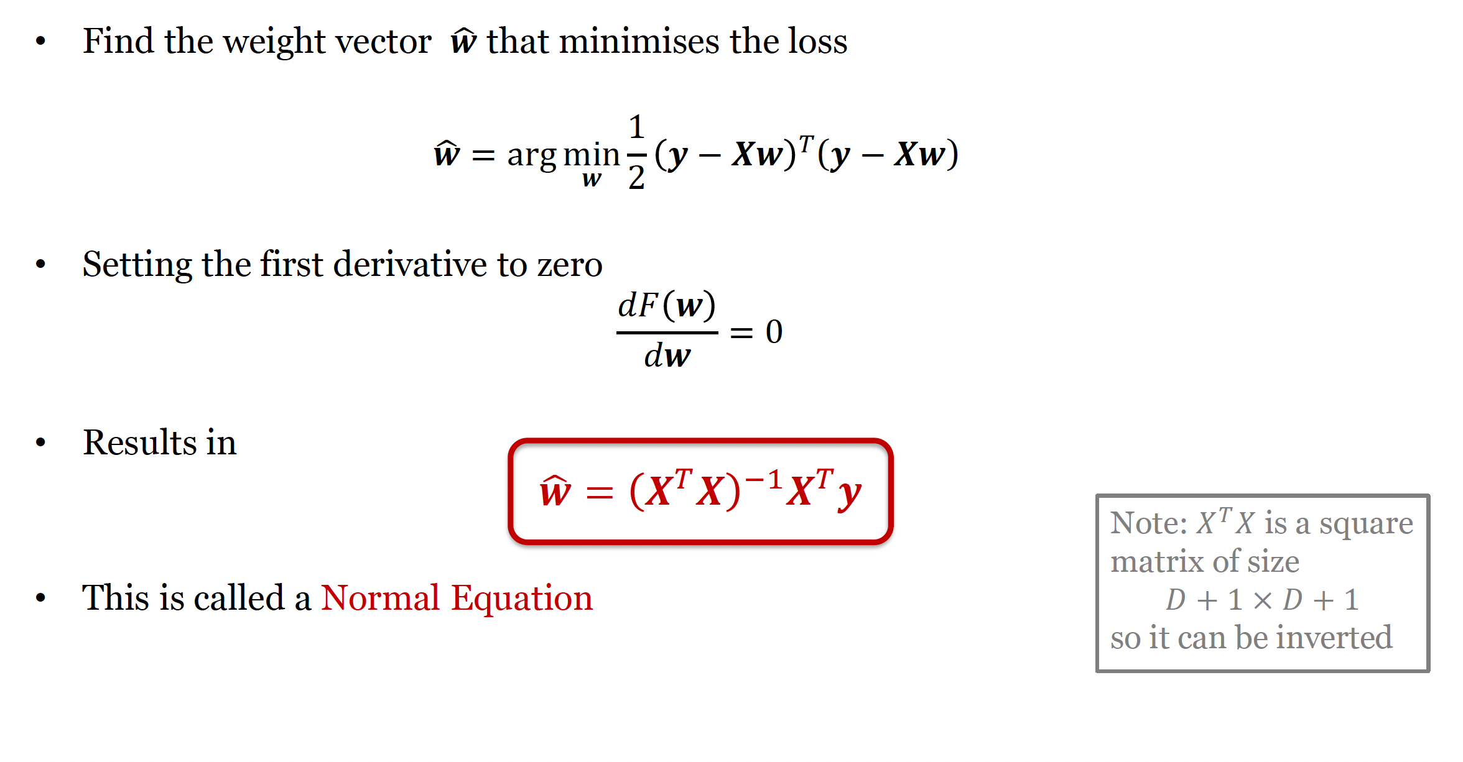
Fit multivariate linear regression model
Notes:
So how do we fitthe multivariate linear regression model to the training data? We need to find the weight vector w hat that minimises the loss function. We can do that by calculating the derivative with respect to w and setting it to zero. This way we will find the solution, which is called the normal equation. Note that X transposed X is a square matrix of size D+1 times D+1 and can therefore be inverted (unless it is singular, but we will talk about that later).

Slide 15
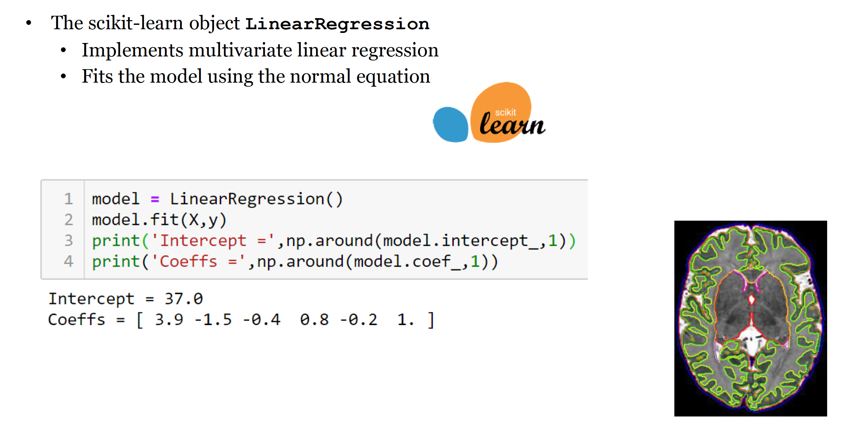
Fit multivariate linear regression model
Notes:
Scikitlearn object LinearRegression, that we have alreadyintroduced, implements multivariate linear regression and the model is fitted using the normal equation. If we fit the linear regression model to predict the age from the six brain tissues, we can see that we have one intercept and six coefficients corresponding to the six brain tissues.

Slide 16
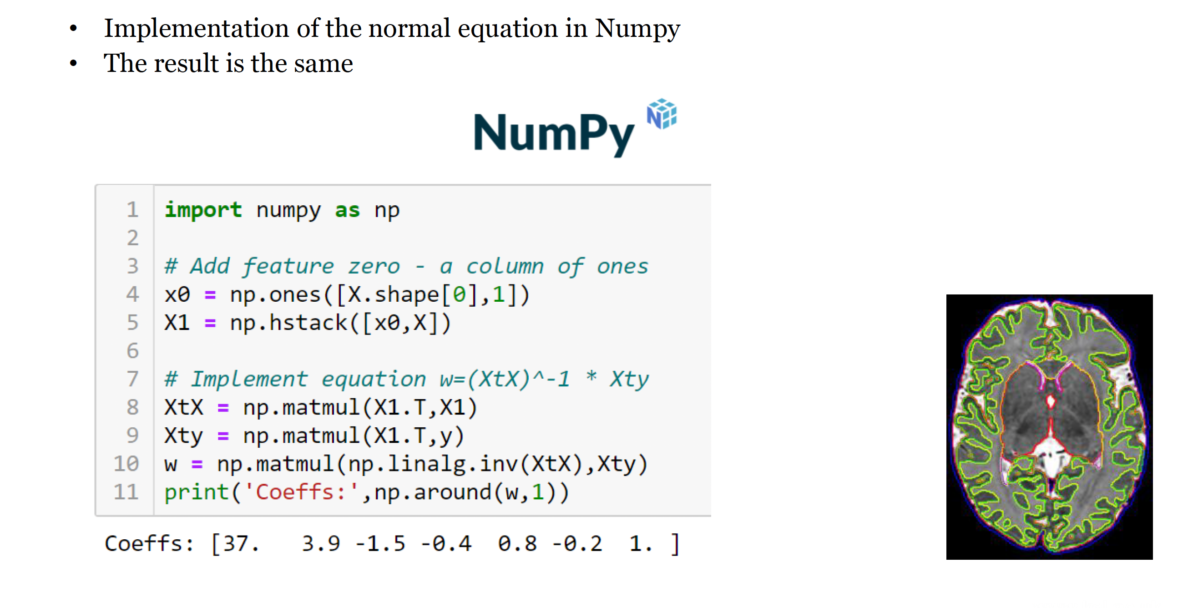
Notes:
This code shows implementation of the multivariate linear regression in Numpy. First, we create the column of ones, that we call x0, using the Numpyfunction ones and add it to the feature matrix X using the function hstackto obtain matrix X1. We transpose the matrix X1 using the fuction.T and multiply it with the original matrix X1 using numpyfunction matmul. We also multiply X1 transposed with the target vector y. Finally we multiply the inverse of the matrix XtX(inverted using np.linalg.inv) with the Xtyto obtain the weight vector w. We can see that the coefficients are exactly the same as the ones from the scikit-learn implementation.

Slide 17
Part II: Multivariate Linear Regression
Gradient descent
Performance and overfitting
Notes:
In the second part of the lecture we will show how to fit linear regression models using gradient descent and look at performance and overfitting.

Slide 18
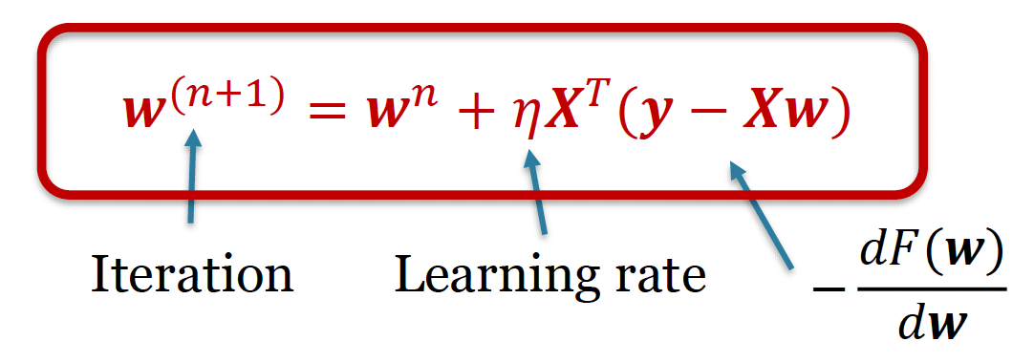
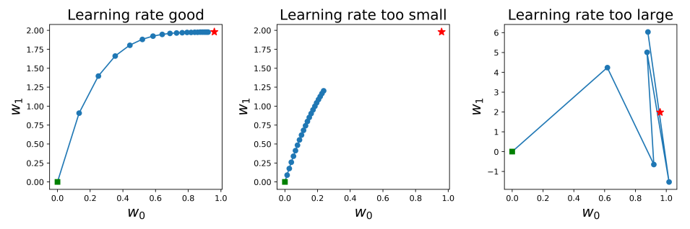
Gradient descent
If number of features is large (~ 100 000+)
normal equation impractical => use gradient descent
Important: good setting for learning rate 𝜂
Notes:
If the number o features is large, inversion of the matrix in the normal equation is impractical. In this case, we can find the weight vector using the gradient descent instead.
This is an iterative process, wherethe weight vector is initialised to a random value and then iteratively updated until it converges to a local minimum. We can see that at each iteration, the weight vector is updated by taking away the derivative multiplied by eta, which is called a learning rate.
It is very important that the learning rate is set well, otherwise the gradient descent will not converge.
Here you can see examples of different learning rates. In the first case the learning rate is correctly set, and the algorithm converges to the correct solution shown by the red star.
If the learning rate is too small, the algorithm will need very large number of iterations and might stop before we reach the correct solution.
If the learning rate is too large, the algorithm will oscillate rather than converge.

Slide 19
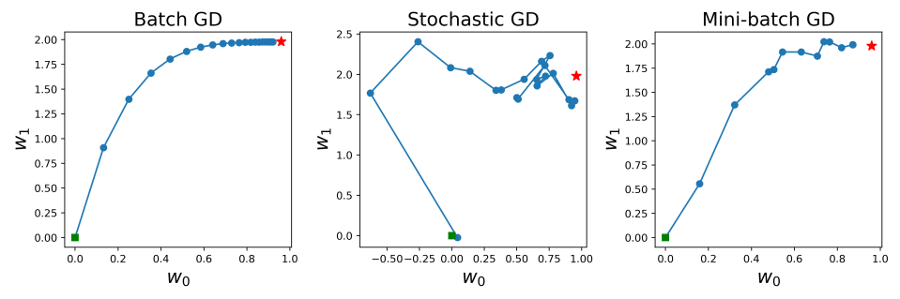
Gradient descent
Batch gradient descent
standard gradient descent using all training data at each iteration
can be very slow
Stochastic gradient descent
uses only one random training sample at each iteration
Very fast but can be unstable
Mini-batch gradient descent
Uses a subset of training data at each iteration
Notes:
In the classical gradient descent, also called batch gradient descent, we use all the samples to update the weight vector at each iteration.
If we have a large number of samples, this process can be very slow.
Stochastic gradient descent only uses one random sample at each iteration, and it is therefore very fast, but it can oscillate and is therefore error-prone.
A good compromise is to use a subset of training data at each iteration, which is called a mini-batch.

Slide 20
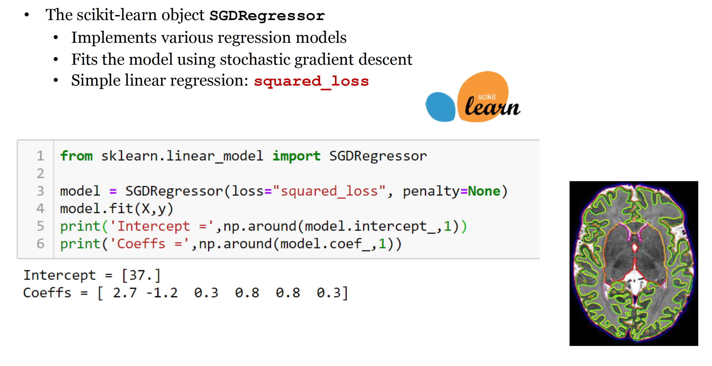
Gradient descent

Slide 21
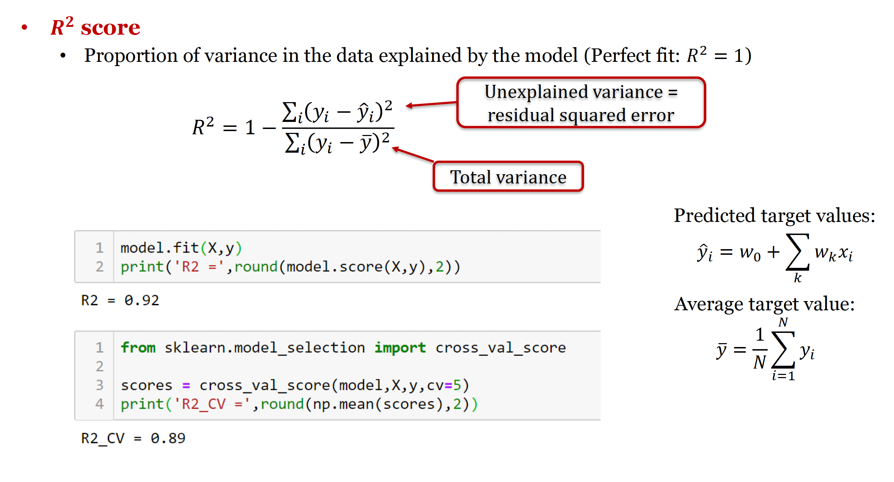
Evaluating performance of regression models
Notes:
We have already seen already that we can measure the performance of regression model using R2 score.
R2 score measures proportion of variance in the data explained by the model and perfect fit results in R2 score equal to 1.
We first calculate the unexplained variance which is actually the residual squared error between expected and predicted target values.
Then we divide it by the total variance in the data.
Note that these expressions should be divided by the number of samples to represent variances, but these factors will cancel each other.
1-proportion of unexplained variance gives us the variance explained by the model.
We are already familial with the code to calculate R2 score in scikit-learn.
When we calculate the R2 score on the whole set
we use model.scoreand we can use function cross_val_scoreto calculate R2 score using cross-validation.

Slide 22
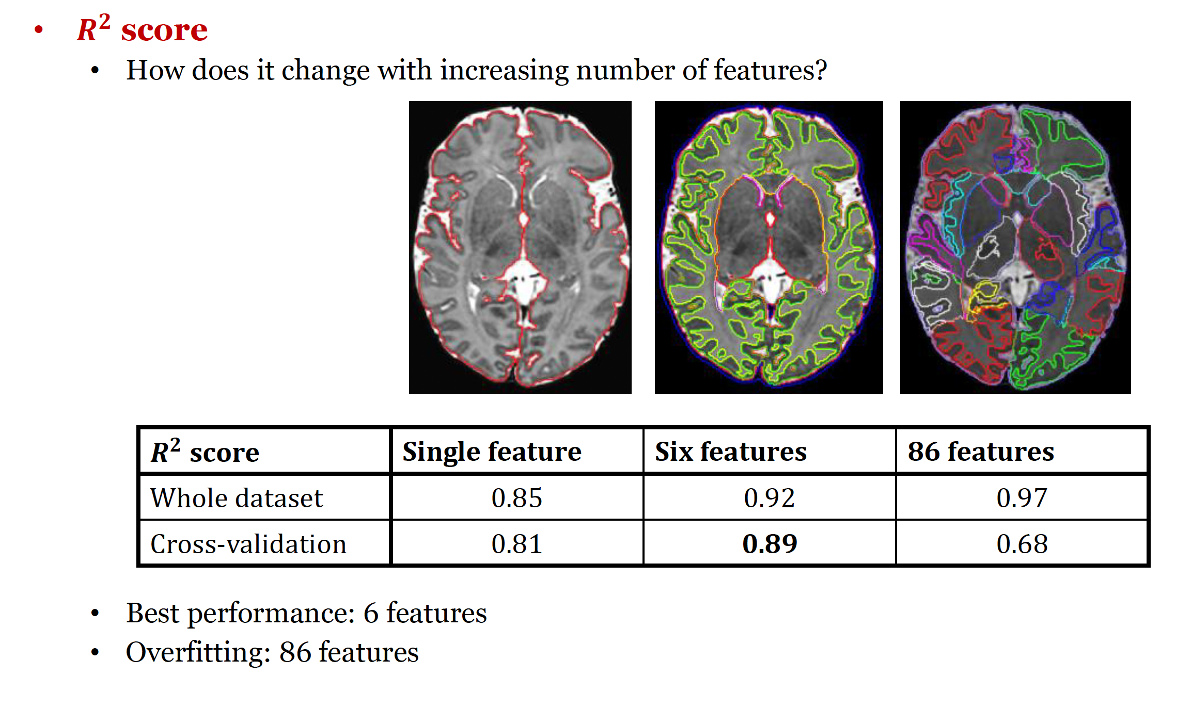
Evaluating performance of regression models

Slide 23
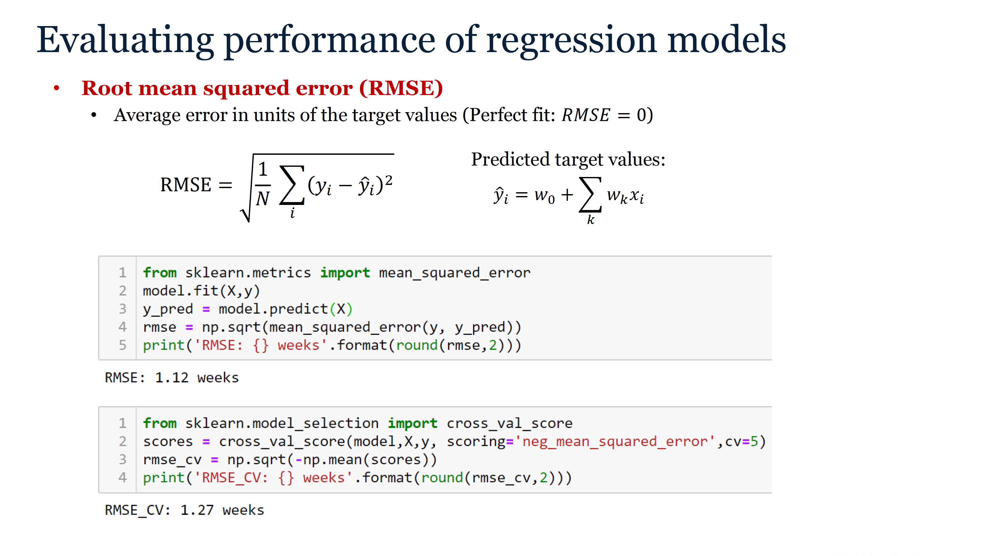
Notes:
Another way to measure performance of the regression models is using root means squared error between expected and predicted target values.
RMSE is an average error in units of the target values and perfect fit corresponds to zero RMSE.
The scikit-learn code to calculate RMSE given here.
To calculate RMSE on the whole set we need to first fit the model and predict the target values, and then we calculate mean squared error between expected and predicted target values, and finally take a square root.
We can of course also fit on training set and predict on test set to measure the performance of the model.
The cross-validated RMSE is calculated using the function cross_val_score, but we set the parameter scoring to negative mean squared error.
This function returns the array of scores for all folds, which need to be averaged.
We put minus because these scores are negative and then take the squared root.

Slide 24
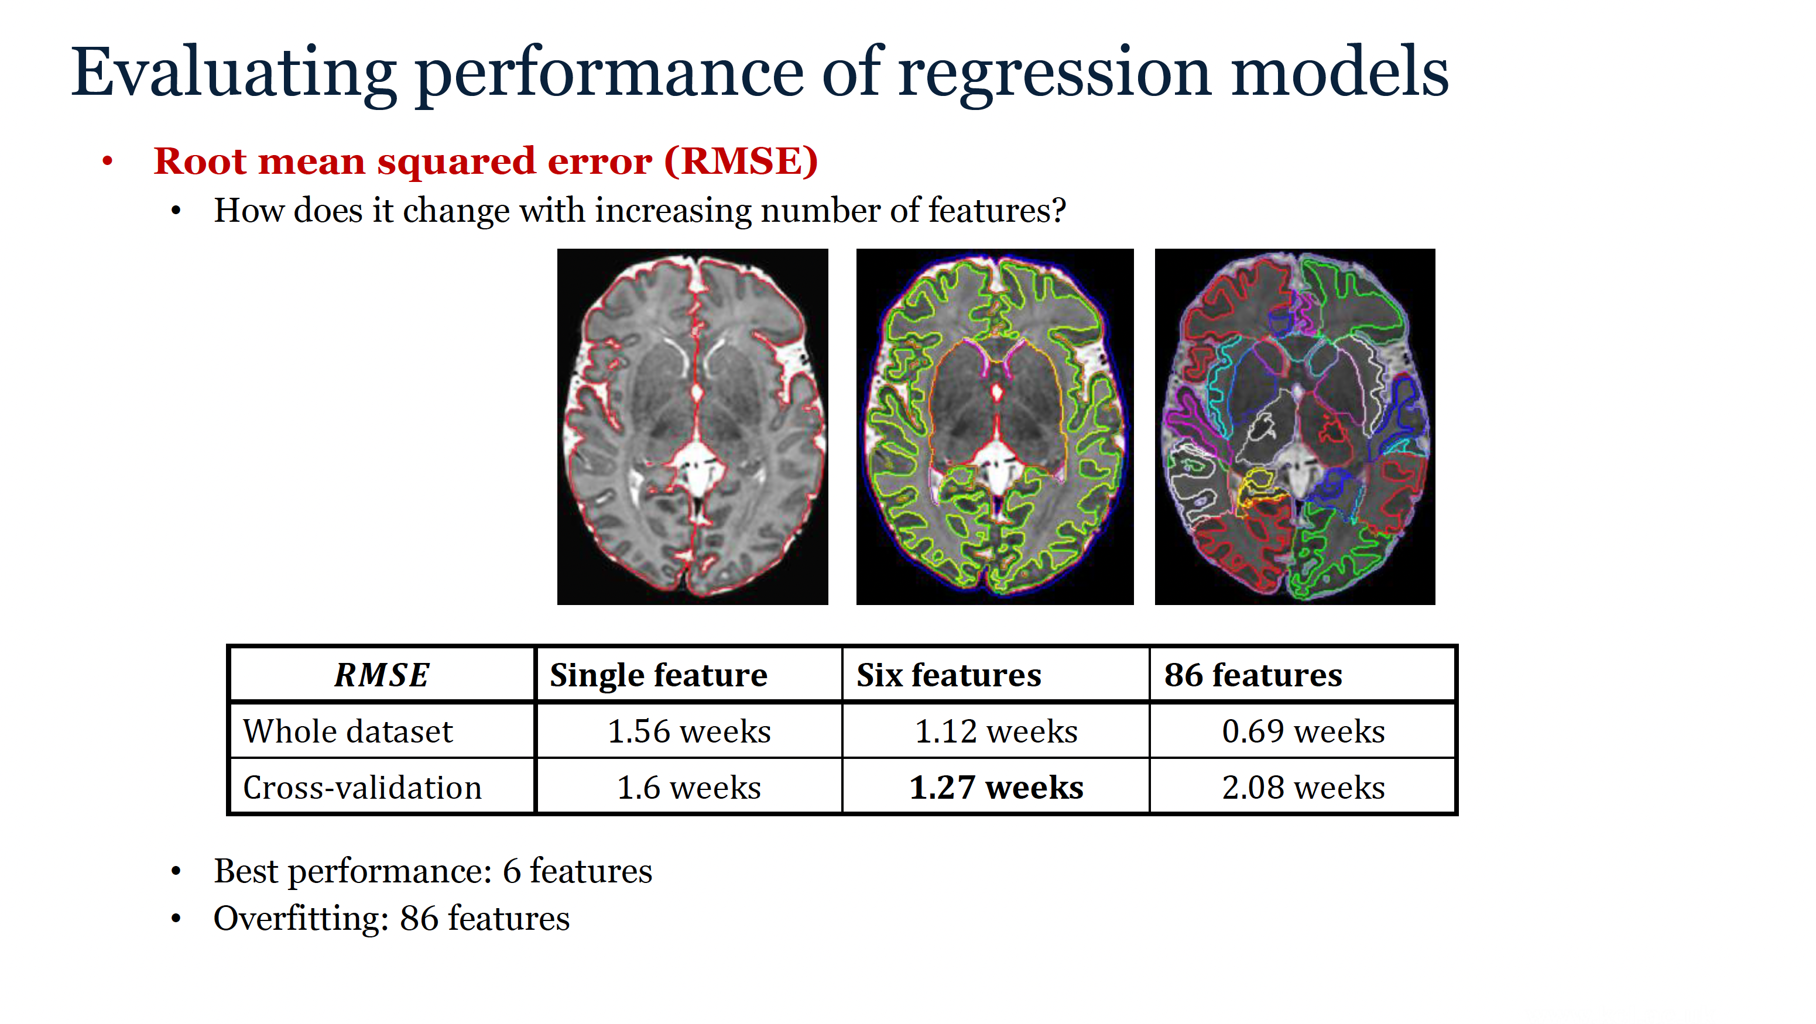
Notes:
Here is the performance for the different datasets measured by RMSE.
We see that RMSE on the whole set decreases with increasing number of features.
When we use cross-validation, the lowest error is achieved for 6 features, 1.27 weeks,
and the models with 86 features is overfitted to the noise in the data, because it has large cross-validated RMSE.

Slide 25
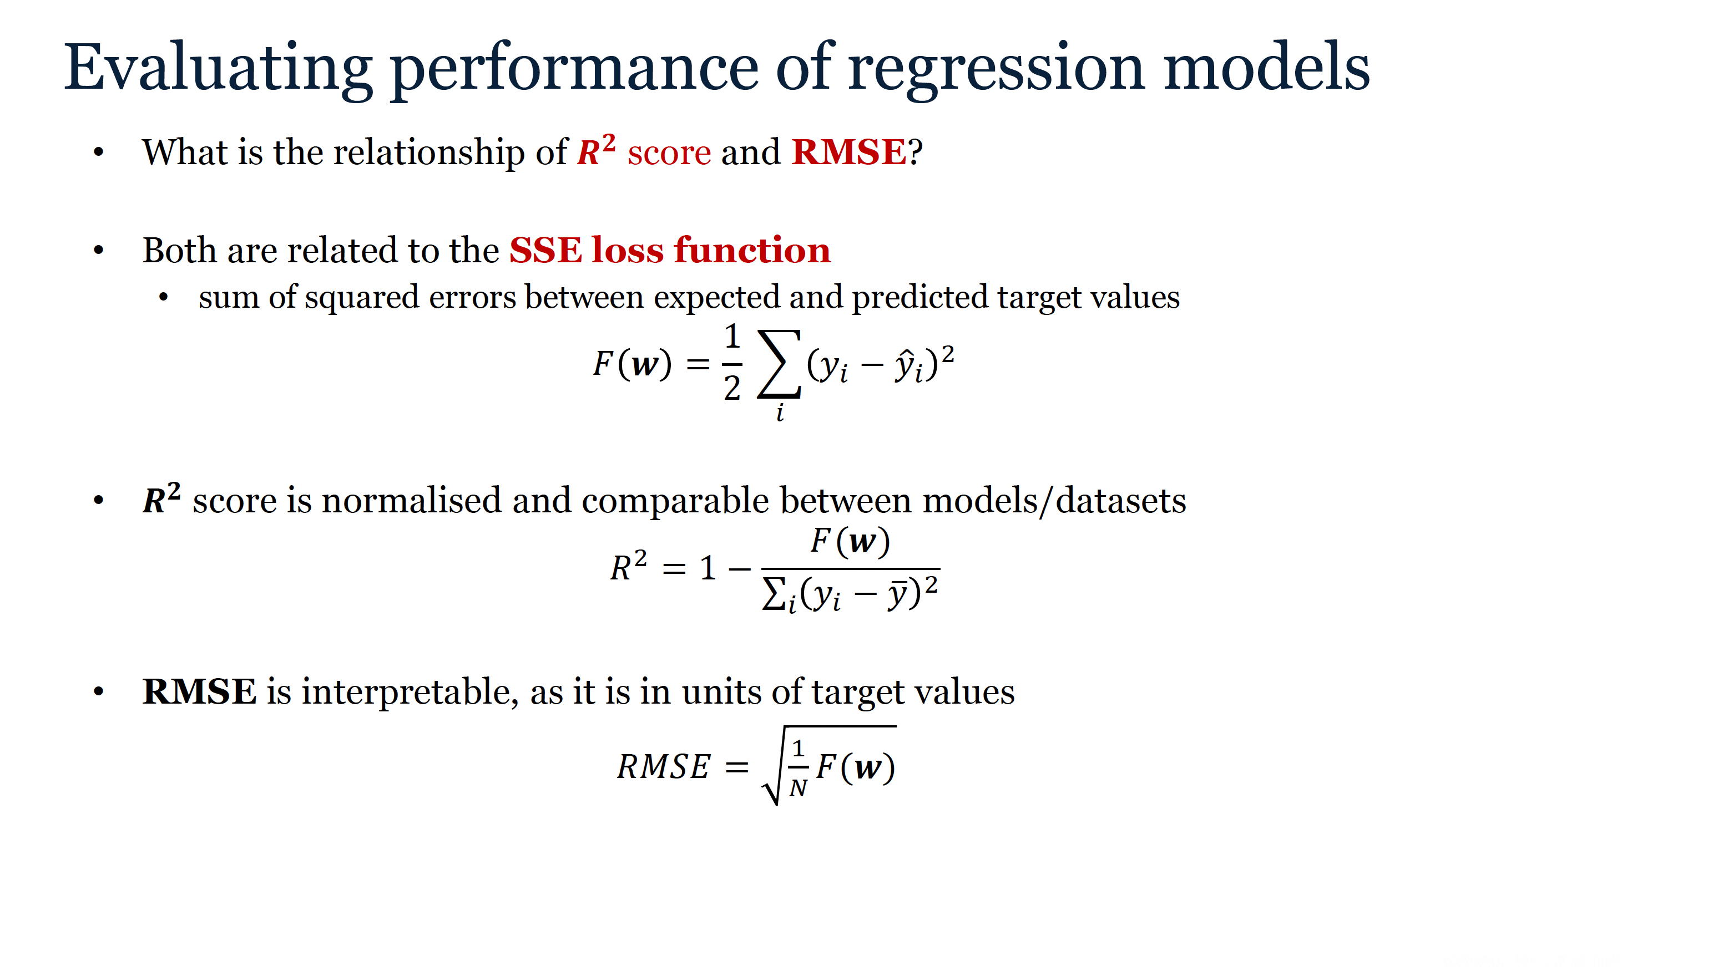
Notes:
So what is the relationship between R2 score and RMSE?
Both are related to sum of squared errors, which is also our loss function.
While R2 score is normalised and therefore comparable between models and datasets, RMSE is interpretable, because it is expressed in units of the target values.

Slide 26
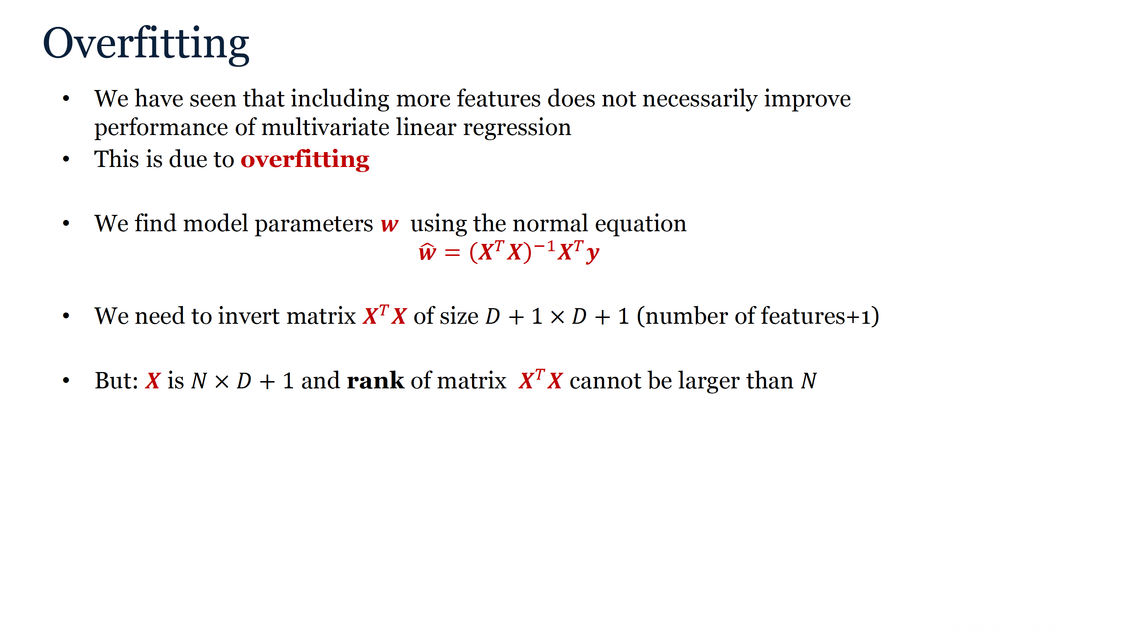
Notes:
We have seen that including more features does not necessarily improve the performance of multivariate linear regression.
This is due to overfitting. So what is the relationship between number of samples, number of features and performance of the model?
Let’s have a look at the normal equation. To find the parameters of the model we need to invert the matrix X transposed X which is square matrix of size number of features plus one.
But the rank of this matrix cannot be larger than number of samples.

Slide 27
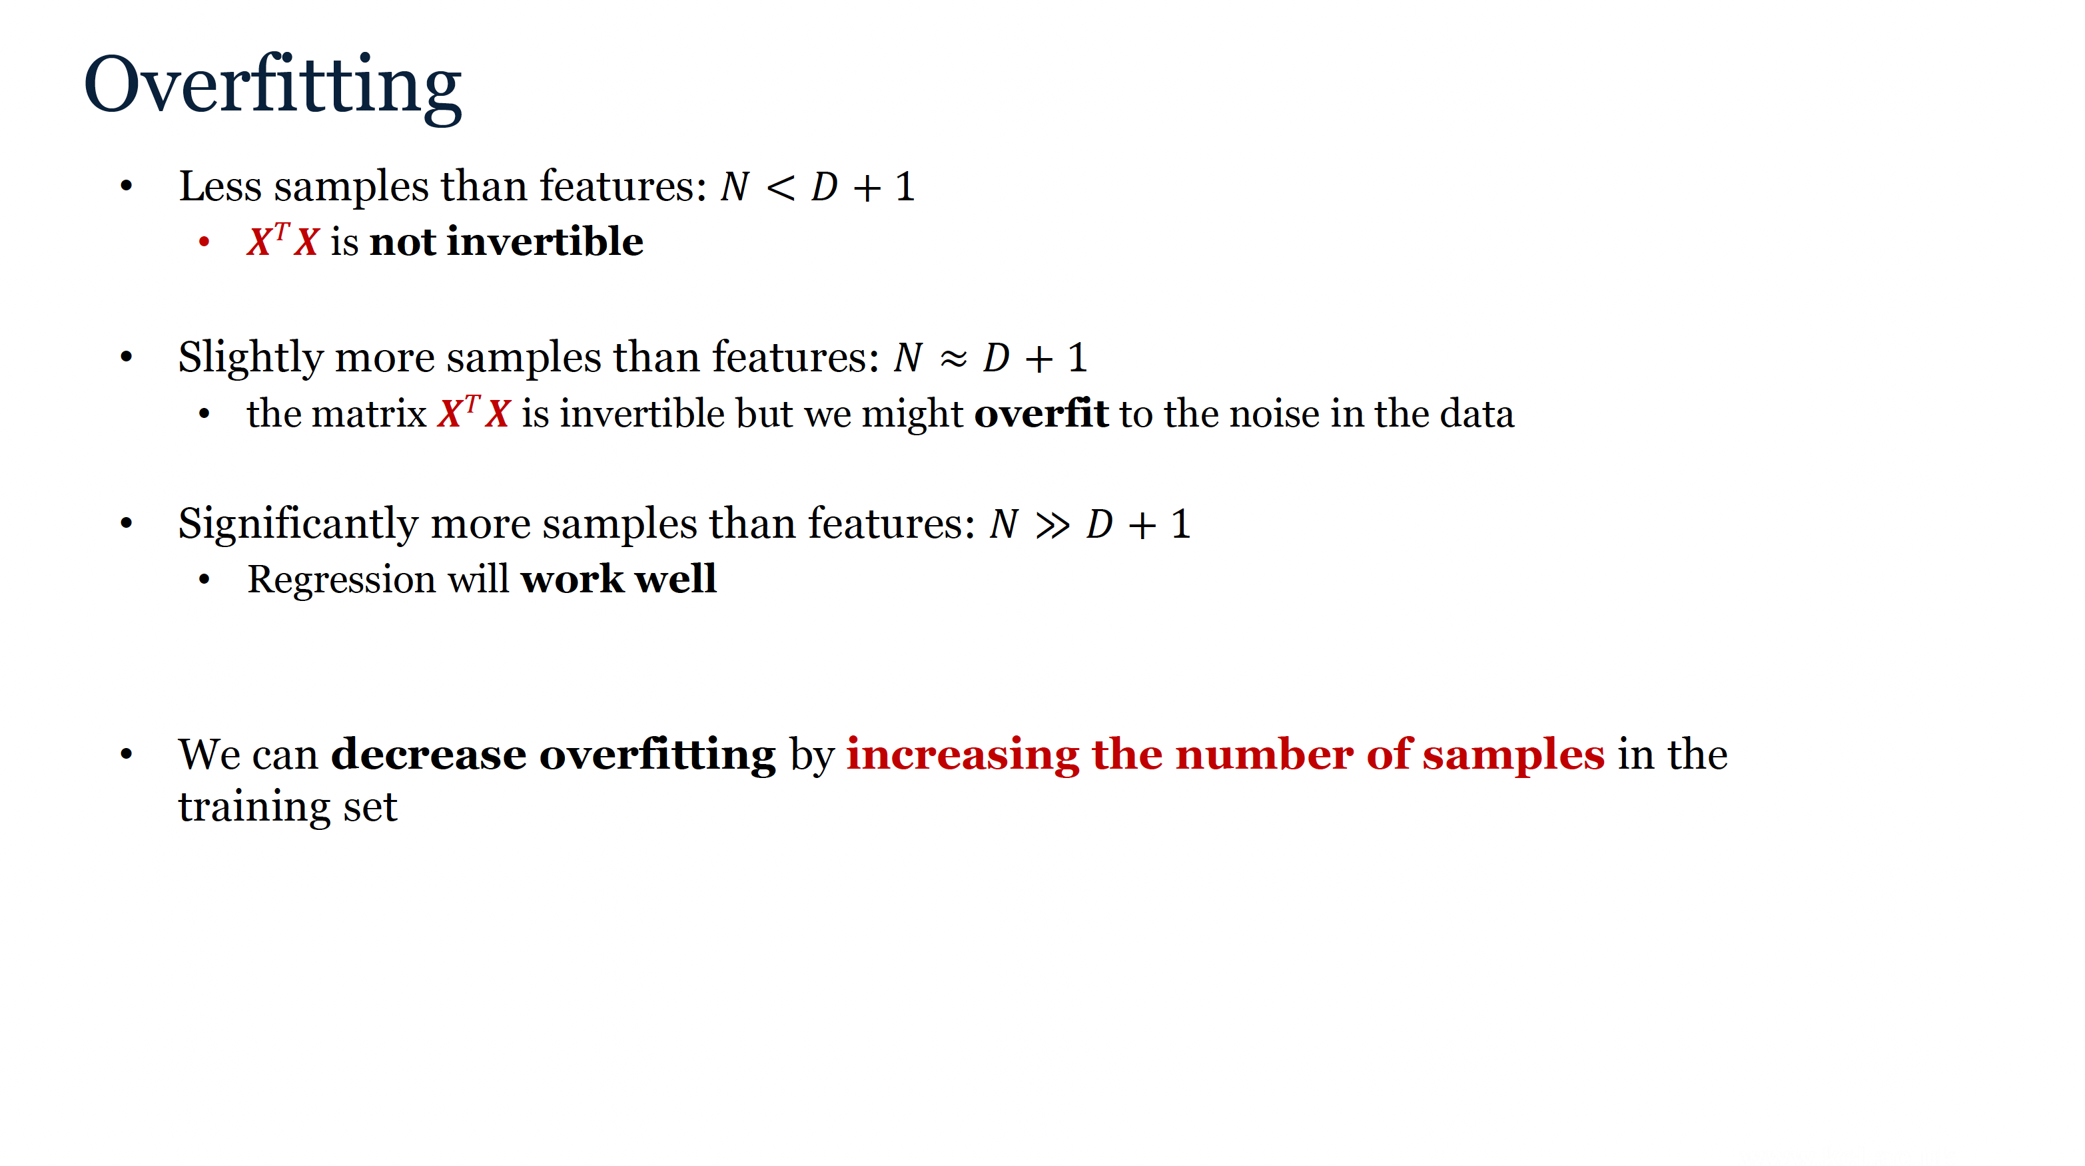
Notes:
If we have less samples than features, this matrix will be singular and there will be no unique model.
If we have only slightly more samples than features, the matrix will be invertible but we might overfit to the noise in the data.
If we have significantly more samples than features, the regression will work well.
We can therefore decrease overfitting by increasing the number of samples in the training set.

Slide 28
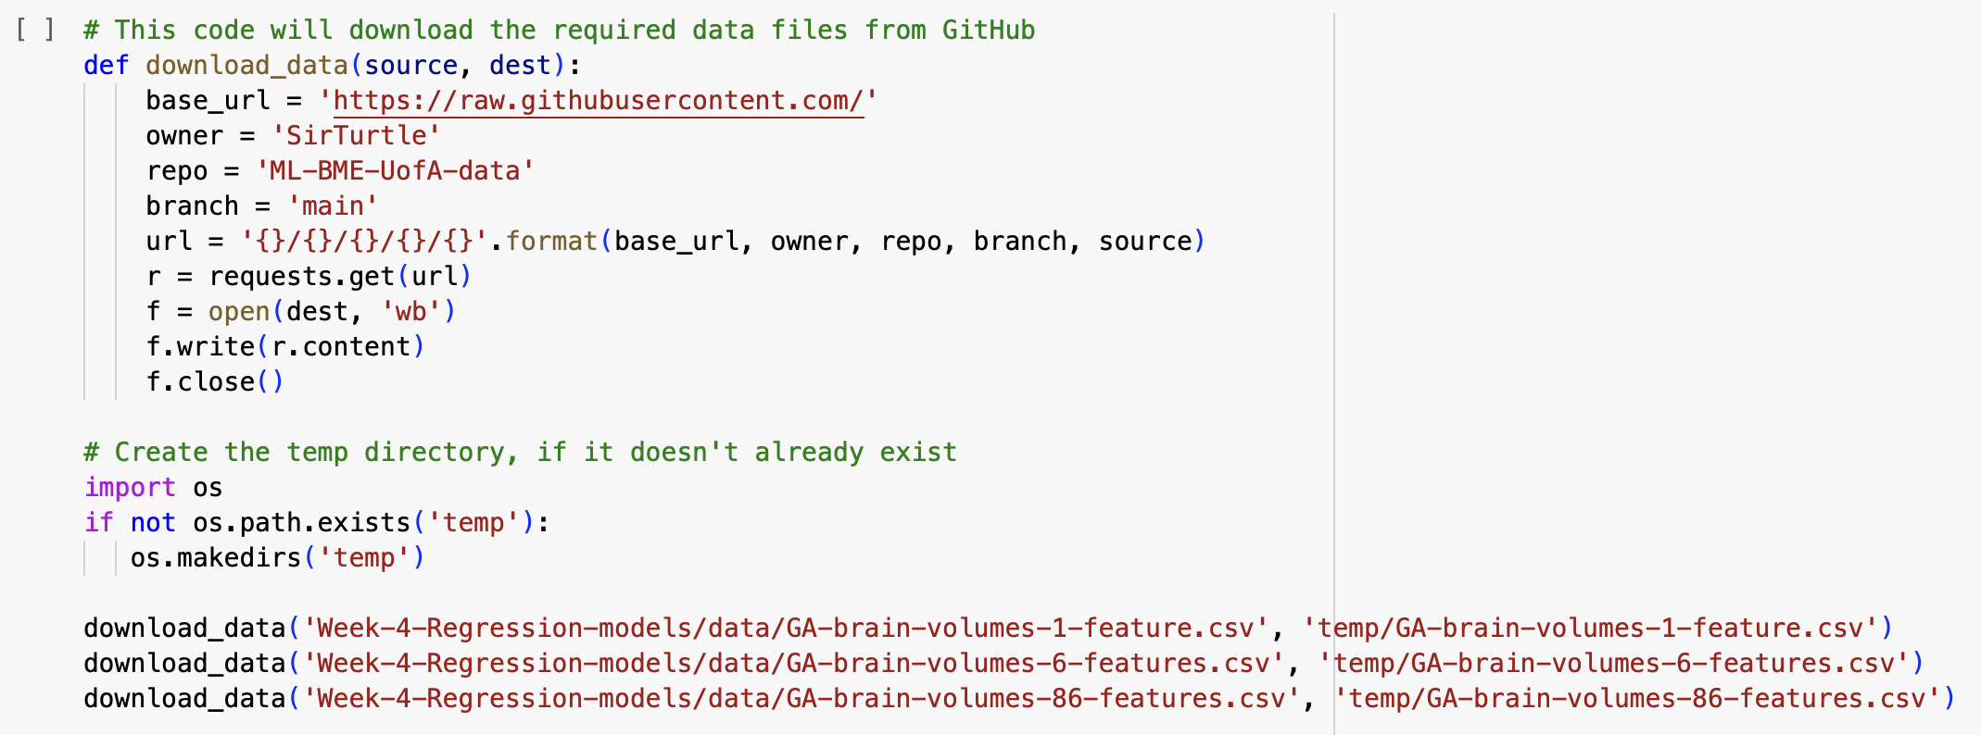
Load the dataset
Load the dataset with 1, 6 , and 86 brain volumes for prediction of GA at scan.

Slide 29
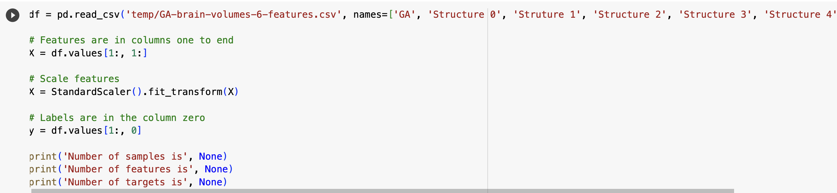
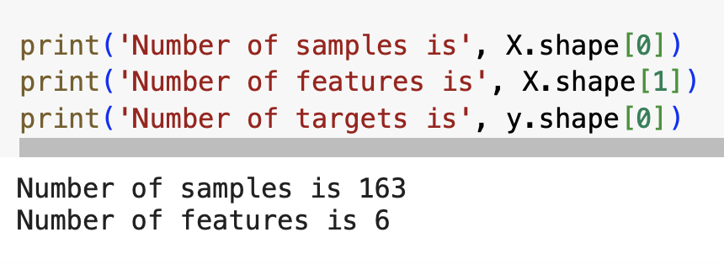
Activity 1: Print the number of samples and features
Notes:
Activity 1: Fill in the code to print out the numbers of sample and features and run the cell.

Slide 30
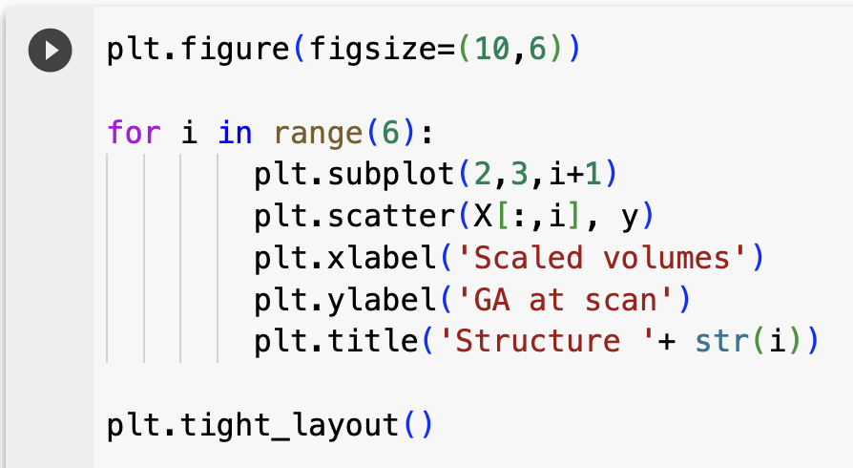
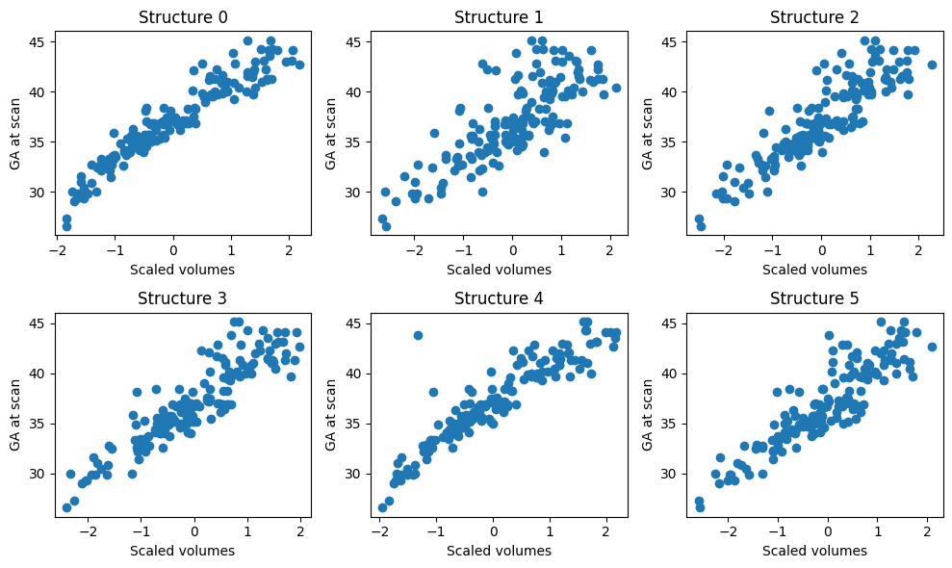
Visualize the dataset
Notes:
First, we will do some EDA. Run the code below to visualise the correlation of individual features of this dataset with the GA.
It is clear visually that all 6 volumes in our dataset are correlated with GA. Next, we will visualize the correlation matrix for all the features and the gestational age.

Slide 31
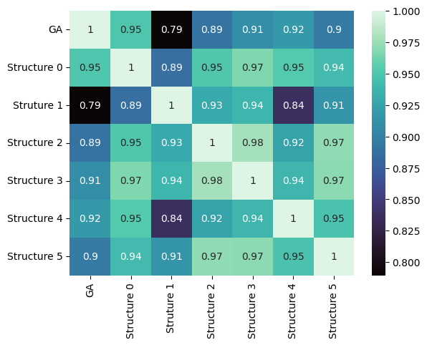
Correlation matrix (between GA and 6 volumes )

Slide 32
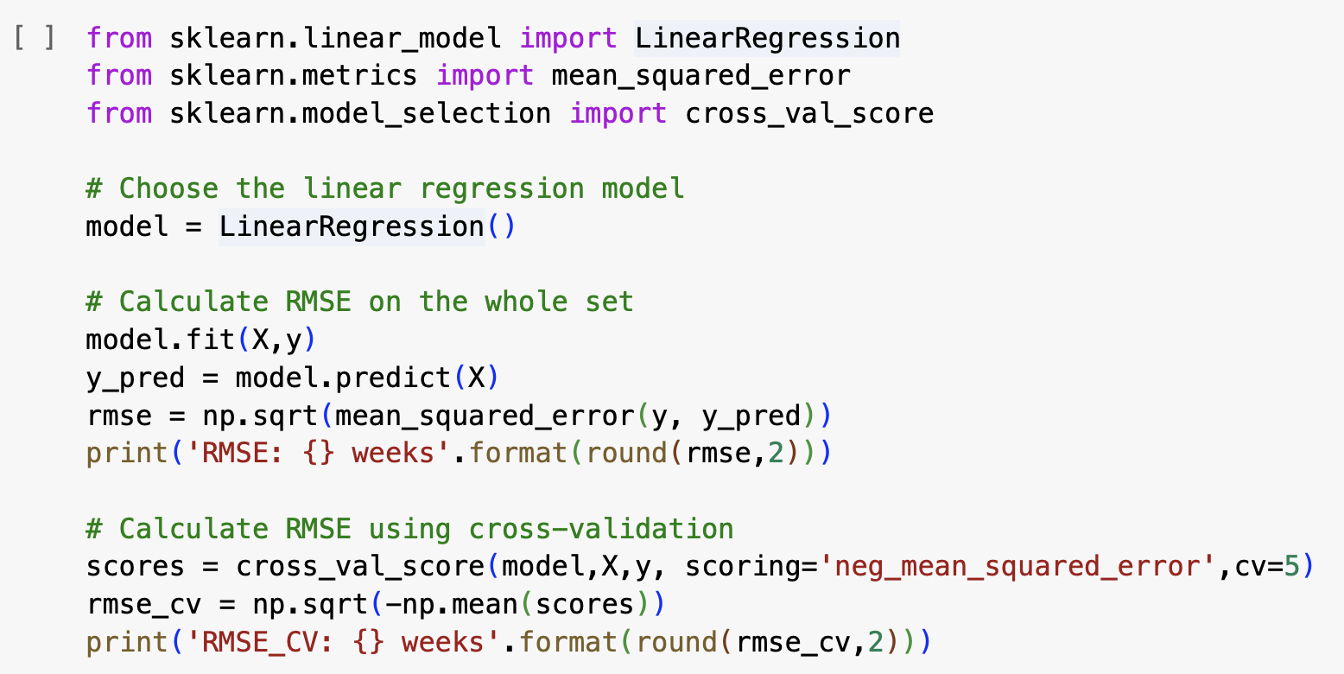
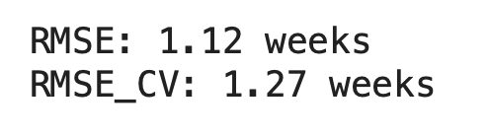
Fit model using normal equation
Notes:
The code bellow fits the LinearRegression model to the data using normal equation.
The performance is evaluated using the Root Mean Squared Error (RMSE).
This is done first on the whole dataset using function mean_squared_error and then using cross-validation implemented by a sklearn function cross_val_score. Run the code.

Slide 33
Activity 2: Question
Question: Notice the RMSE. In which units is it? We calculate RMSE on the whole dataset and using cross-validation. Which one is larger? We will later compare these errors to other regression methods.
Answer: The RMSE is in weeks and represents the average error in estimated age of the baby.

Slide 34
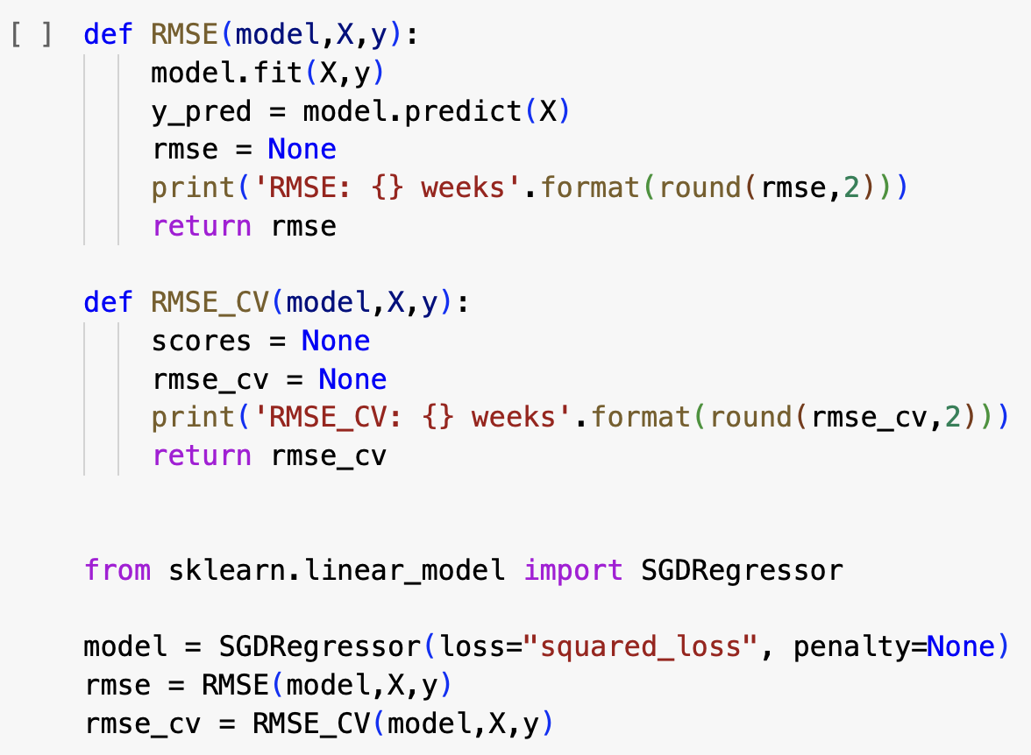

Activity 3: Fit model using SGD
We will now fit the model multivariate linear regression model using stochastic gradient descent implemented in SGDRegressor.
Activity 3: In the previous cell you have seen how to calculate RMSE. Complete the functions
RMSE to calculate RMSE on the whole dataset
RMSE_CV to calculate cross-validated RMSE
Run the code and compare the error to the fit using normal equation, that we have performed before.

Slide 35
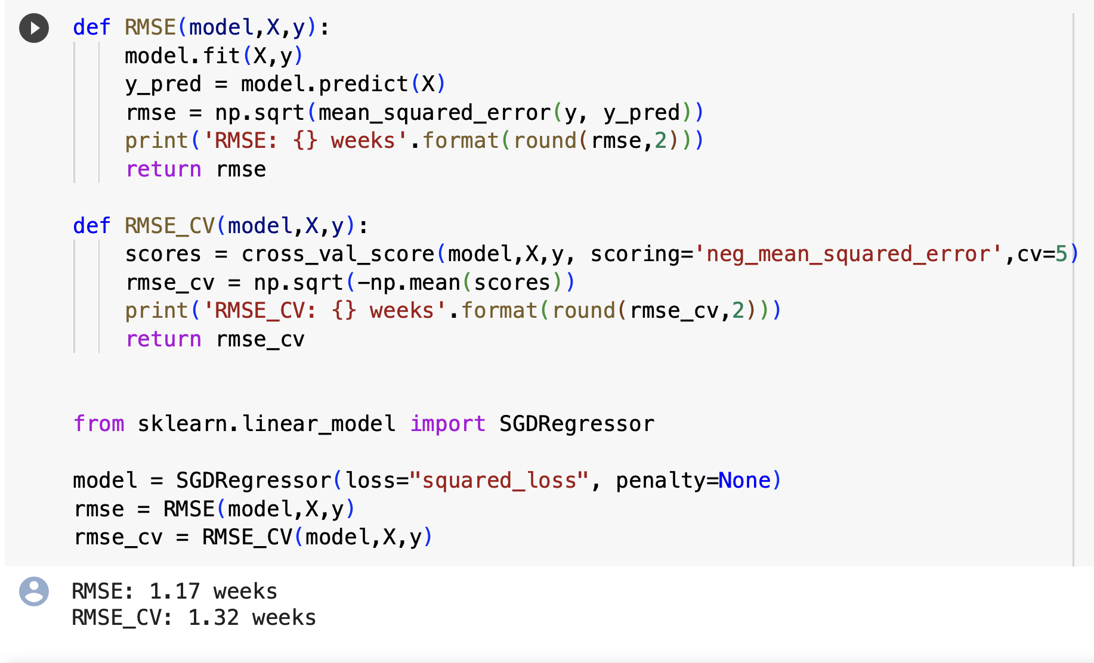

Activity 3: Fit model using SGD

Slide 36
Exercise 1: Normal equation in Numpy
Homework

Slide 37
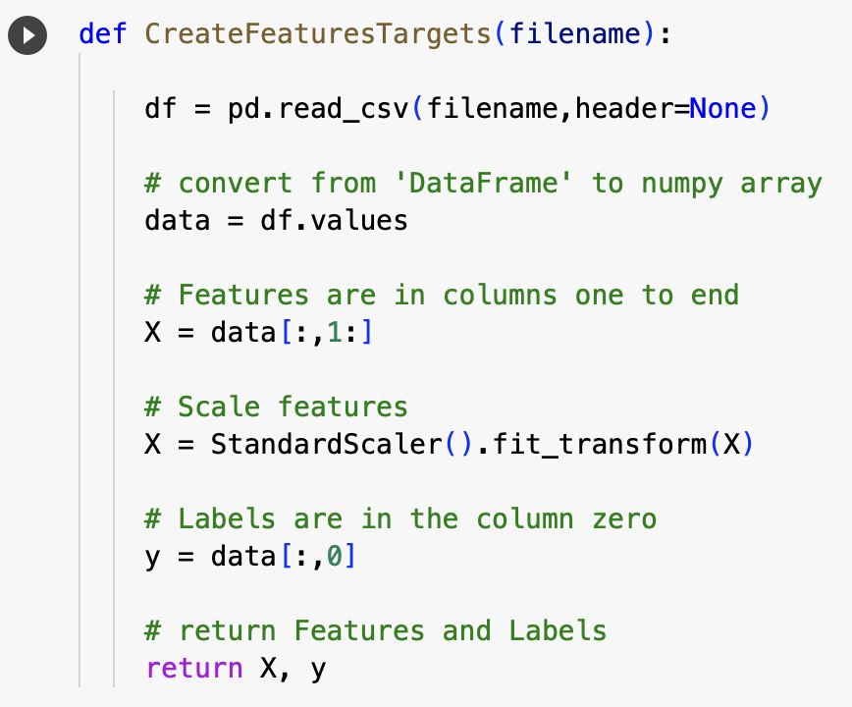
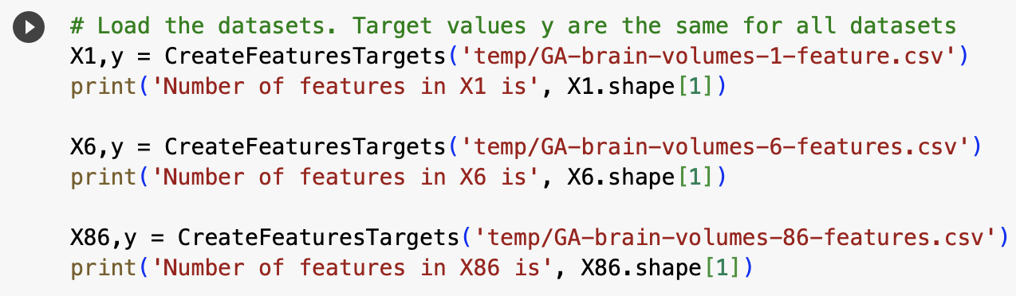
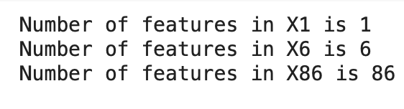
Exercise 1: Compare performance of linear regression models with different numbers of features

Slide 38
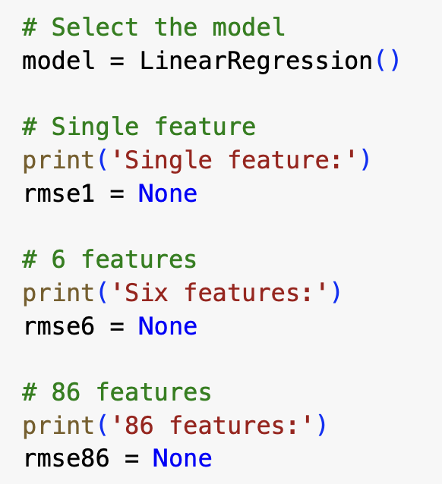
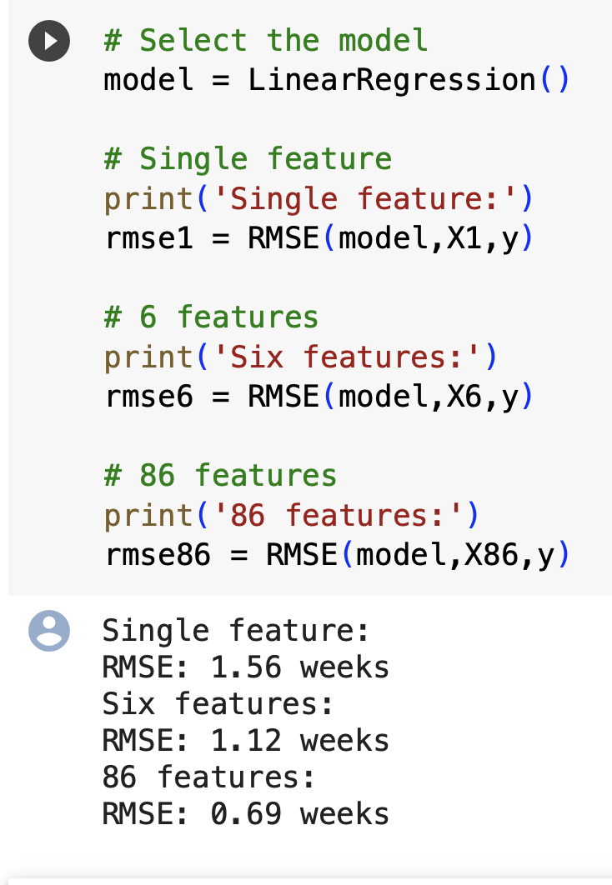
Create a linear regression model and calculate RMSE on the whole set
What happens with RMSE on the whole set as we increase the number of features? Can you interpret this behaviour?
Answer: RMSE increases with increasing number of features. This can be due to improvement of the fit but also due to overfitting. To recognise the overfitting we need to calculate RMSE using cross-validatation.
Notes:
In the next step we will create a linear regression model and calculate RMSE on the whole set. Use the function RMSE that we have created previously. Fill in the code below and run it.

Slide 39
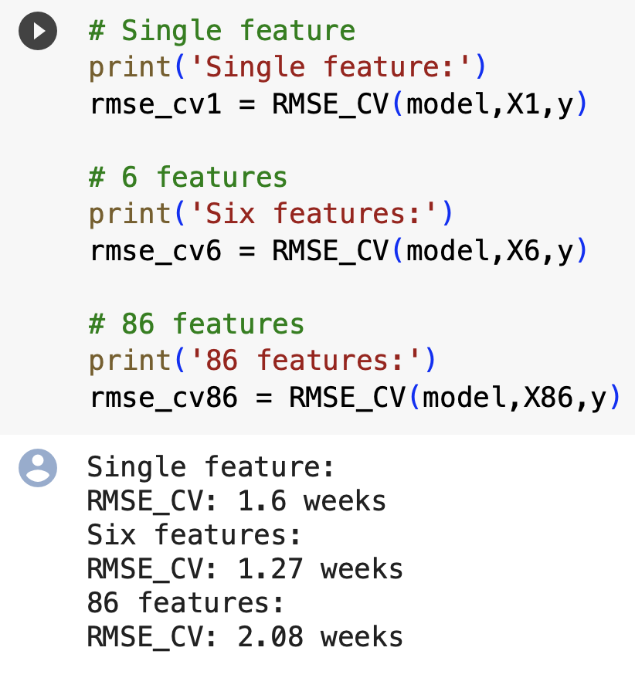
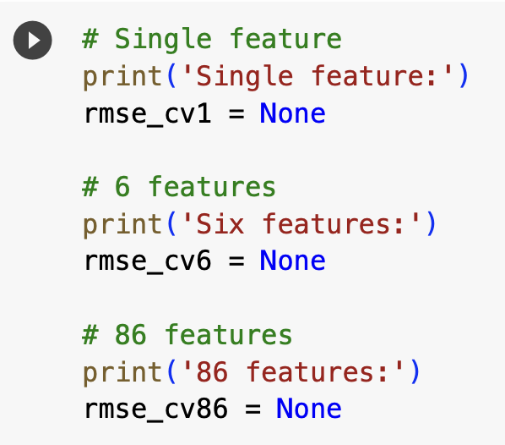
Cross-validated RMSE for the three different features
Question: Which model performs the best? Which model is overfitted?
Answer: The model with 6 features performs the best, because it has the lowest RMSE_CV=1.27. The model with 86 features has RMSE=0.69 and RMSE_CV=2.08 which is a big difference and it is therefore clearly overfitted.
Notes:
Now let's calculate the cross-validated RMSE for the three different feature matrices. You can use function RMSE_CV that we created before to calculate and print out the scores.

Slide 40
Part III: Penalised Linear Regression
Notes:
We will start with mathematical formulation and fitting of the linear regression model.

Slide 41
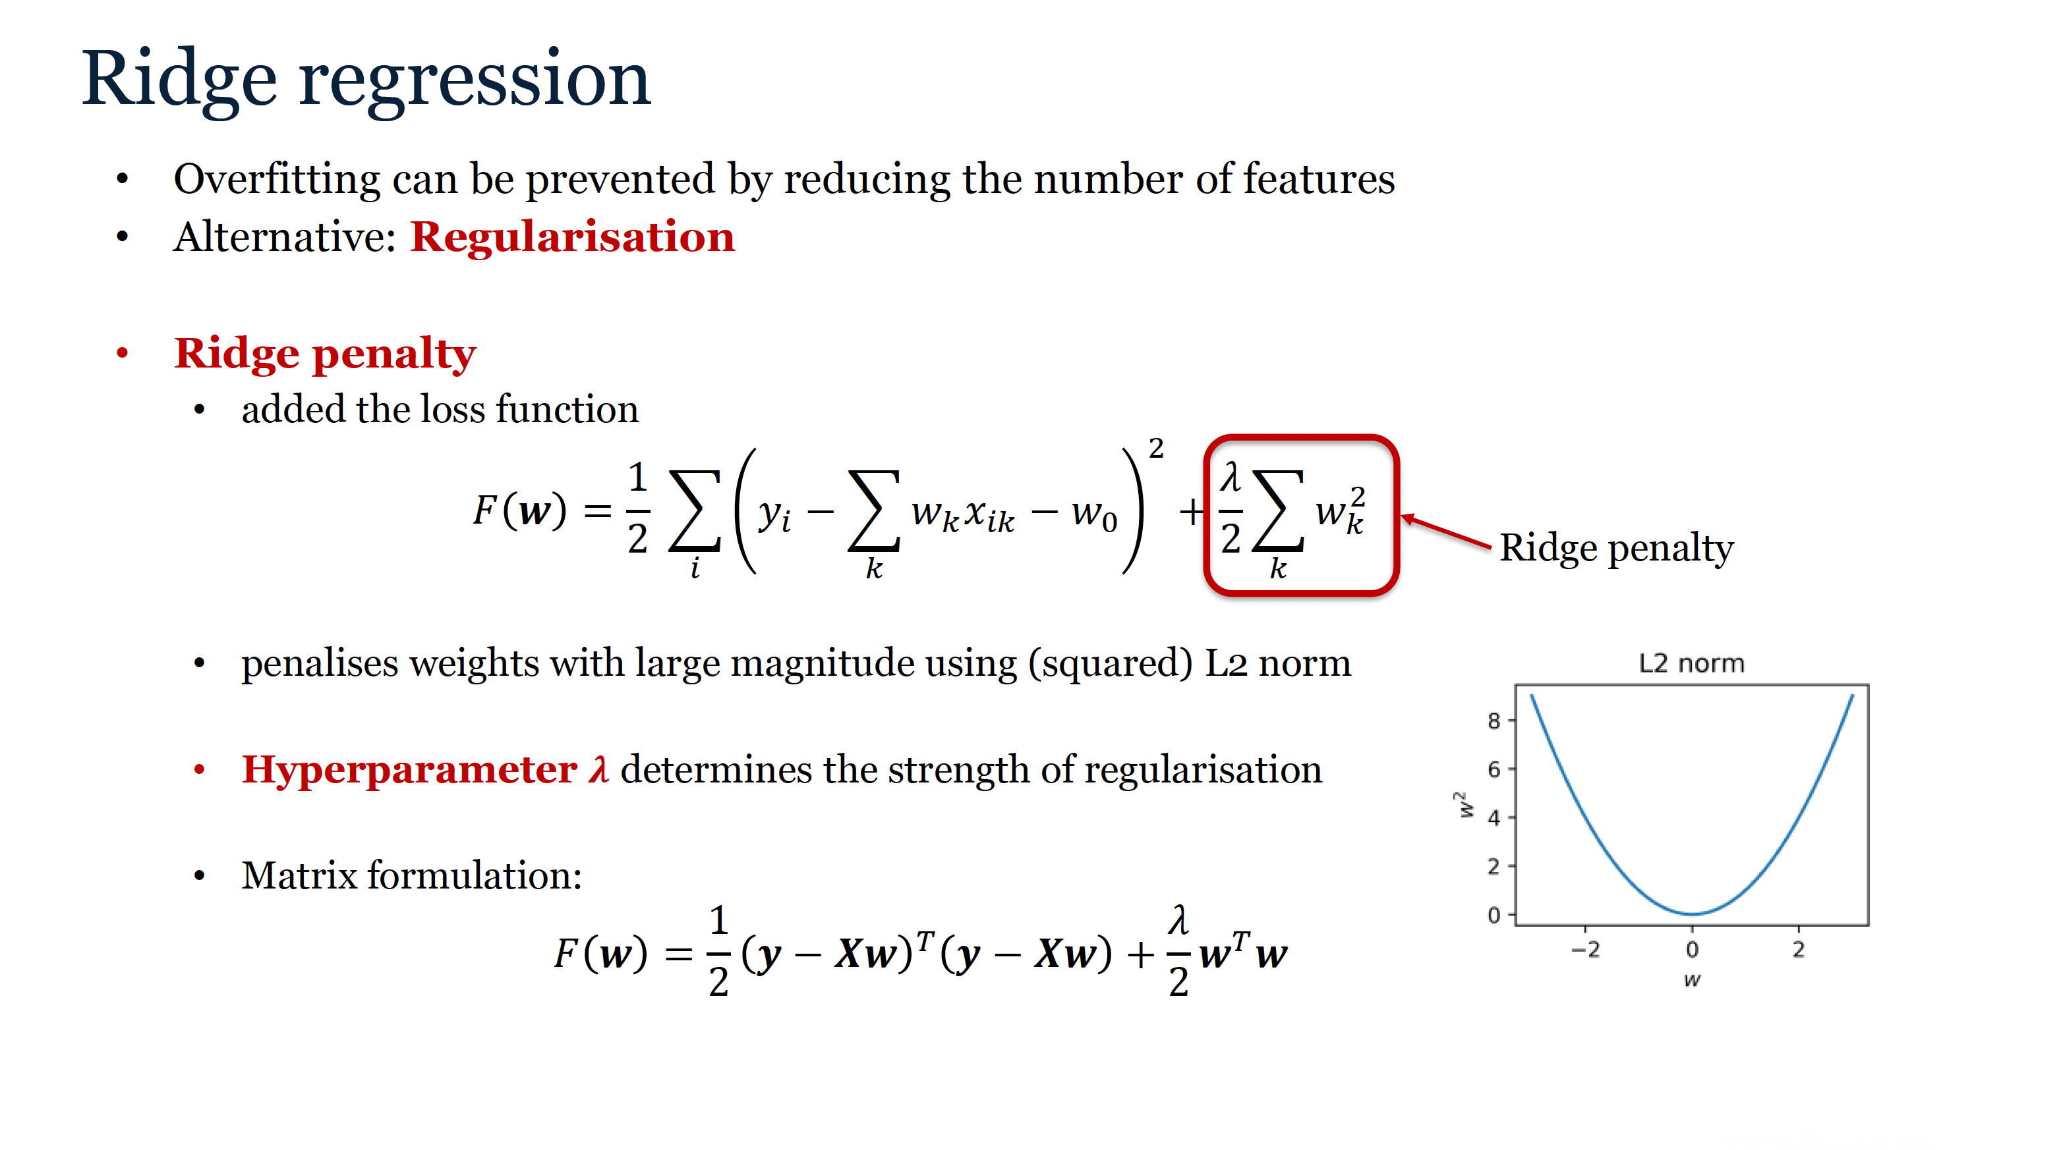
Notes:
We have seen that overfitting in multivariate linear regression can be addressed by reducing the number of features. An alternative is to keep the same features and regularise the model instead. To do that we can add a penalty to the loss function that will discourage weights with very large magnitude. If the penalty is calculated using squared L2 norm of the weight vector (which is equal to sum of squares of the individual weights), it is called Ridge penalty. The hyperparameter lambda determines the strength of the penalty term. The ridge penalty can be expressed in matrix form as w transposed times w. The penalty for a single weight is plotted in this graph. You can see that it is zero for a zero weight, and rises quadratically as the magnitude of the w increases, whether it is negative or positive.

Slide 42
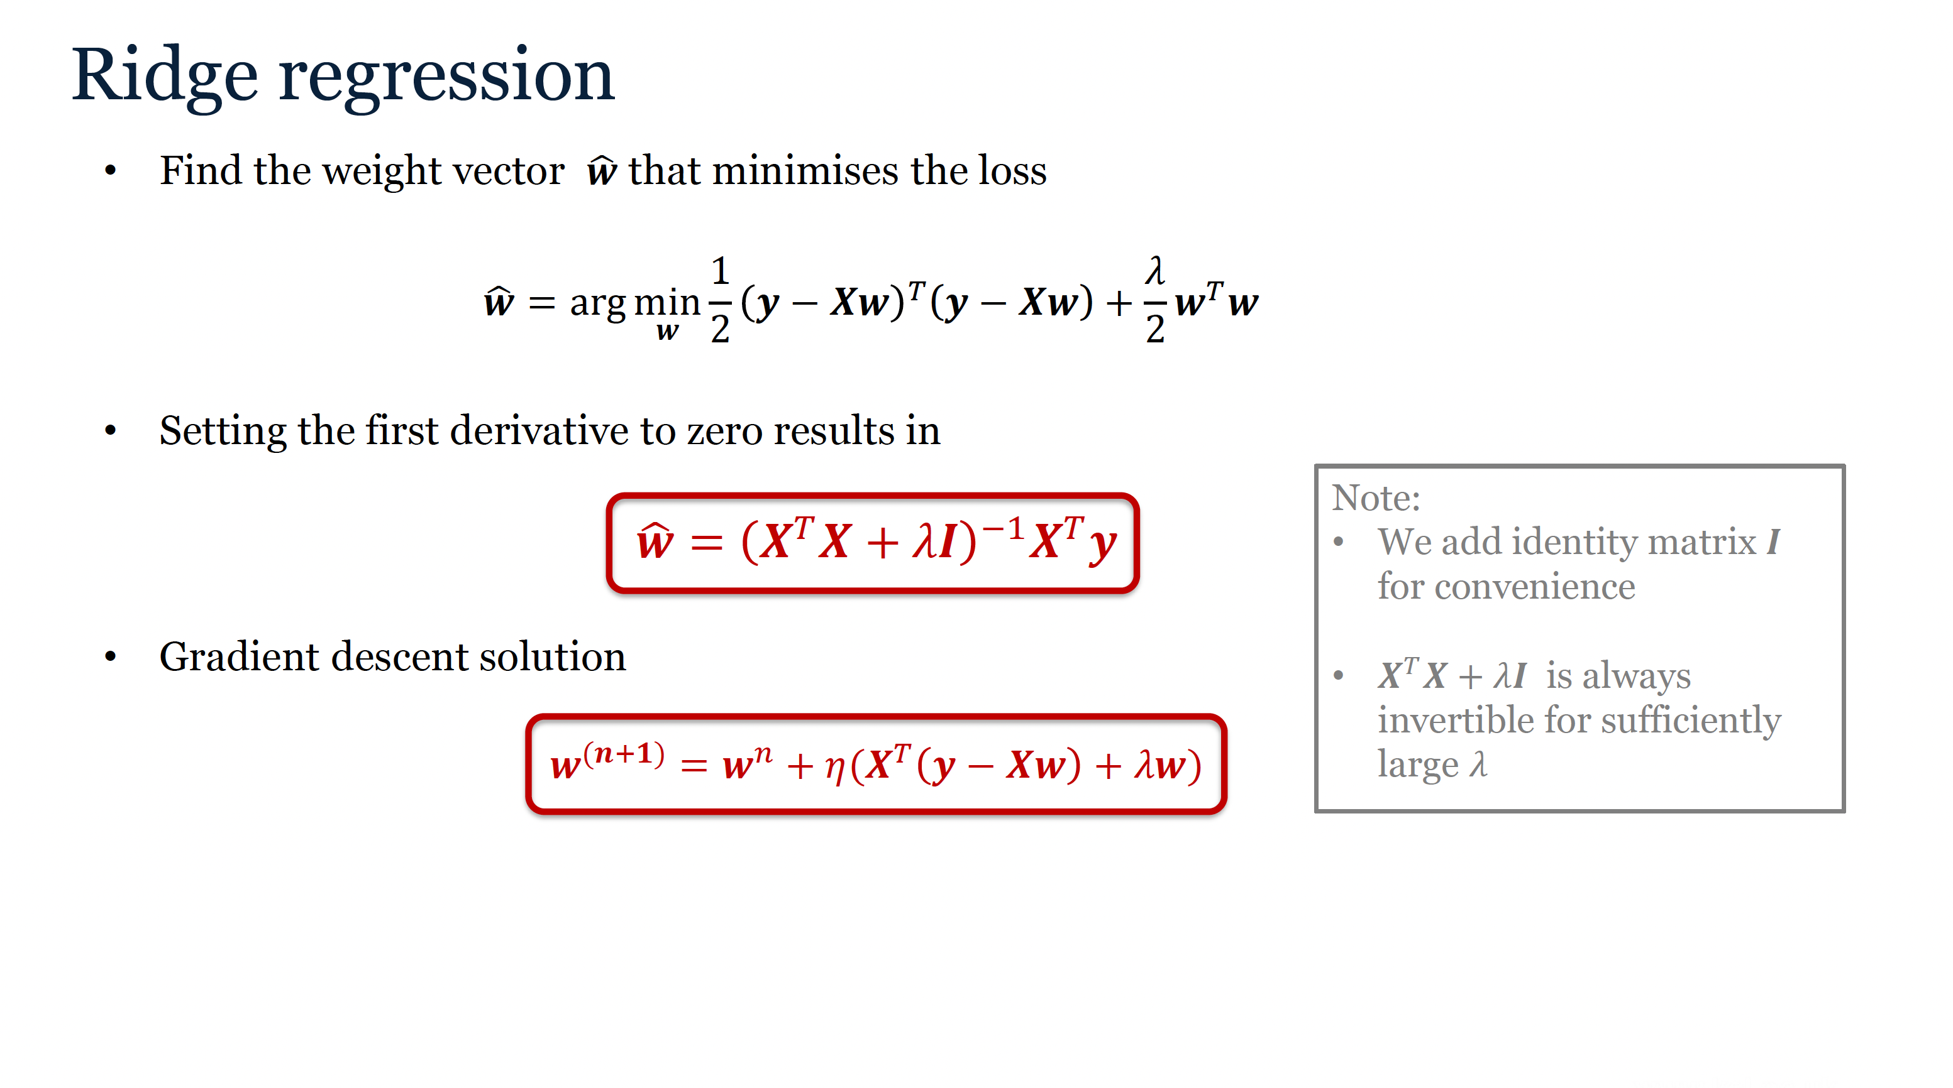
Notes:
We find the solution w to the Ridge regression problem by minimising the loss function. If we set the derivatives of the loss function with respect to the weight vector w to zero, we obtain an analytical solution to the Ridge regression problem. Note, that we add lambda to the diagonal of the matrix X transposed X before we invert it. This will make the solution less prone to overfitting and the matrix will be always invertible, as long as lambda is sufficiently large. The formula for the gradient descent is also given here. We need to calculate the first derivative of the Ridge loss function to obtain this formula. The derivation is similar to the non-penalised linear regression.

Slide 43
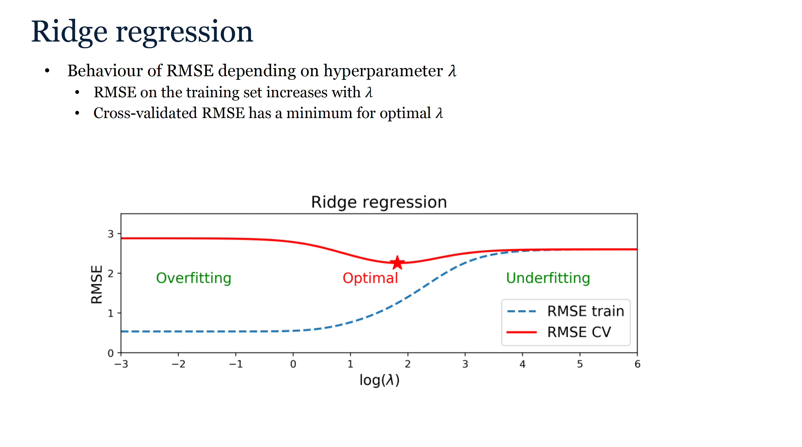
Notes:
The hyperparameter lambda is found using cross-validation. In this graph we plotted an example of RMSE depending on the logarithm of lambda, which is calculated on training set (blue dashed line) and through cross-validation (red solid line). You can see that for very small lambda there is very little regularisation. The training error is small, while CV error is large, and dataset is clearly overfitted. As we come closer to the optimal lambda, training RMSE increases and we reach a minimum in CV RMSE. We choose the lambda corresponding to this minimum. As lambda increases further, both training and CV RMSE keep rising until they reach a stable value.

Slide 44
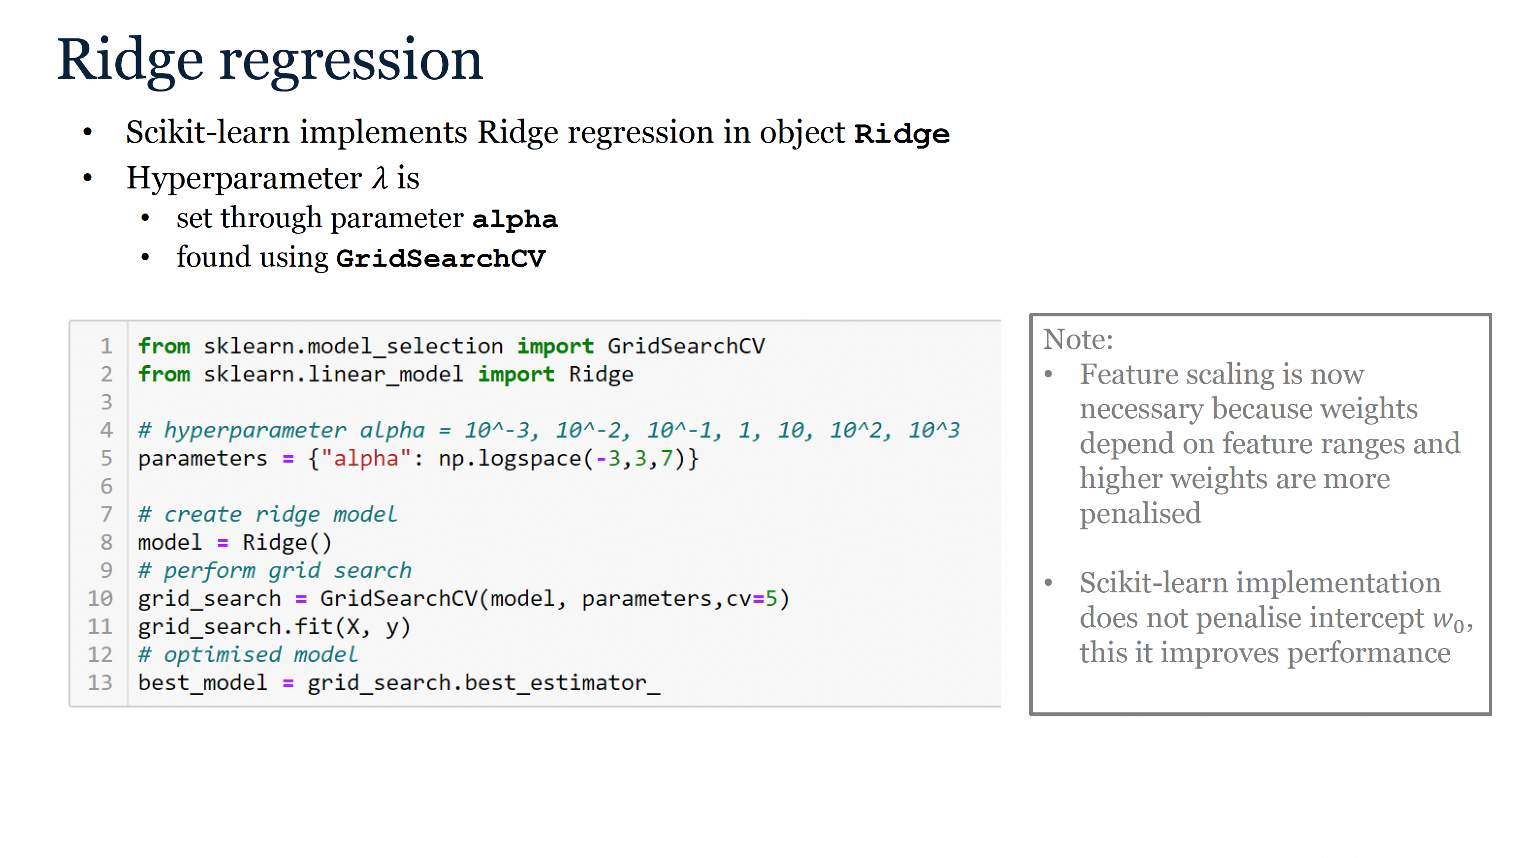
Notes:
In scikit-learn we can implement Ridge regression using the object Ridge. Hyperparameter lambda can be set through parameter alpha. We can find the optimal lambda using the object GridSearchCV. This time it is better to define the parameter grid on logarithmic scale, using numpyfunction logspace, to achieve good coverage of potential parameter values.
Note that feature scaling is now essential, because weights depend on feature ranges and larger weights will be penalised more. Another important implementation detail is that scikitlearn does not penalise the intercept w_0, because this reduces bias error due to the regularisation.

Slide 45
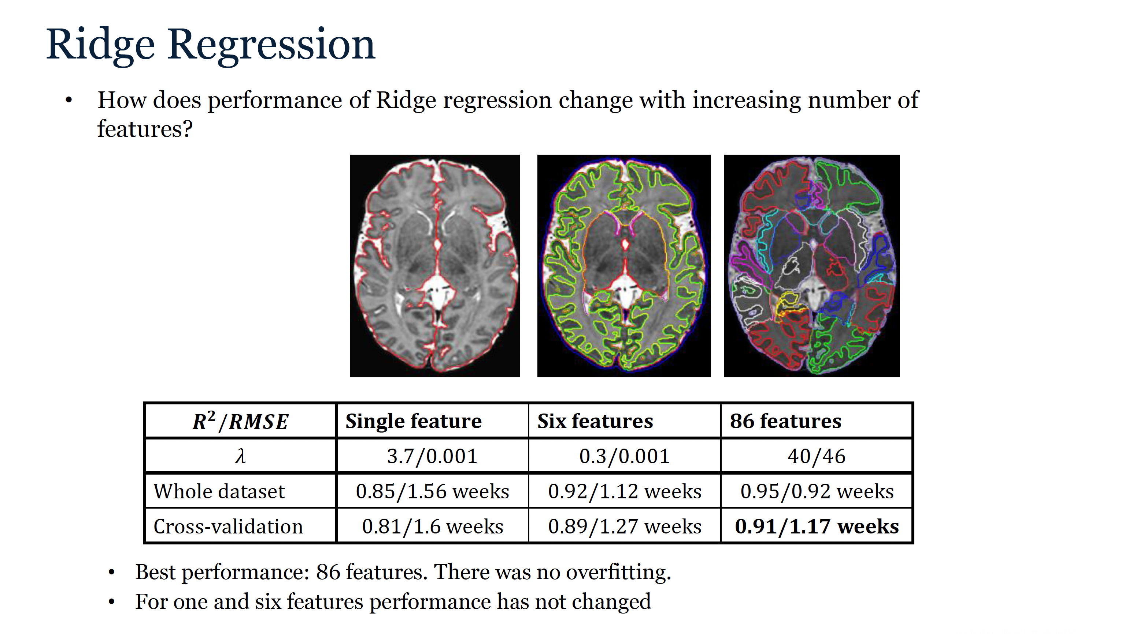
Notes:
In this table we give comparison of performance of the Ridge regression for the three different datasets that we already explored for multivariate linear regression. While performance of the datasets with 1 and 6 features is the same as before, we can see that Ridge regression can take advantage of the larger number of features, and this results in best performance so far, with R2 score 0.91 and RMSE 1.17 weeks.

Slide 46

Notes:
Least absolute shrinkage and selection operator, or LASSO, is an alternative regularisation approach to Ridge. Lasso regression penalises weights with large magnitudes using L1 norm, which is equal to sum of absolute values of individual weights. We will show later, that LASSO penalty produces sparser solutions than Ridge. We can express the loss function of the LASSO regression in matrix formulation. We multiply the weight vector with the vector sign(w), which is filled with ones, minus ones and zeros, depending on the sign of the individual weights, to express the absolute value.

Slide 47

Notes:
The LASSO penalty is not differentiable, and an analytical solution therefore does not exist, but we can still calculate a subgradientof L1 norm, which is equal to sign(w). We can still use gradient descent to find the solution, and the iterative formula is given here.

Slide 48

Notes:
Scikitlearn object Lasso implements the Lasso regression. We fit the Lasso regression the same way as the Ridge regression. We set the hyperparameter lambda using the parameter alpha, and find the solution using GridSearchCV, with parameter grid defined on a logarithmic scale.

Slide 49

Notes:
Let’s have a closer look at differences between Ridge and Lasso regression. Ridge and Lasso penalties both decrease the magnitude of the weights. We can clearly see that when we plot the weights of different regression models for 86 brain structures. Coefficients of the multivariate linear regression, depicted by blue circles have clearly larger magnitudes than the coefficients of Ridge and Lasso regression depicted by red stars and green triangles. When we compare the Ridge and Lasso penalties we see that Ridge penalises weights with large magnitude more than Lasso, but Lasso penalises weights with small magnitude more than Ridge, and this results in sparsity of Lasso solution. We can see that almost all Ridge weights, depicted by red starts are non-zero. For Lasso, only a small number of weights are non-zero, which we call a sparse solution. Therefore Lasso can be used for feature selection. The results of prediction of age at scan from volumes of 86 brain structures show that Ridge performed better that Lasso for this application.

Slide 50

Notes:
Finally, let’s have a look at theoretical properties of Ridge and Lasso regression to gain more insight. We can rewrite the penalised regression loss, where R(w) represents the penalty term, as a constrained optimisation problem. We minimise the sum of squared errors (SSE) loss subject to a constraint that the penalty term is smaller or equal to a constant value B. This constant will be related to the hyperparameter lambda. In case of multivariate linear regression, we have no penalty. In this plot we have weight 1 on x axis and weight 2 on y axis. The value of the SSE loss is plotted using the yellow colour for high values and blue colour for low values. The minimum of the SSE loss is shown by the white star. If we now add the Ridge penalty, the L2 norm of the weight vector (w1,w2) will have to be inside or on the boundary of the white circle. For sufficiently small B, this will take the solution closer to zero. If the penalty is L1 norm, the solution will have to be within the diamond shaped region. For sufficiently small penalty, this will also take solution closer to zero, but on a different path.

Slide 51

Notes:
In this video you can see how B changes of the solution of penalised regression. For large B, the minimum of the SSE loss is inside the region, there is no penalty and lambda is 0.
For smaller B minimum of SSE is outside of the region and lambda is non-zero. As B decreases, lambda increases. Note that the solutions do not follow the same paths with increasing lambda. While for Ridge regression the weights decrease together and reach zero at the same time. For Lasso the smaller weight w2 reaches zero first, leaving only w1. Lasso therefore produces sparse solutions if lambda is sufficiently large.

Slide 52

Part IV: Non-linear Regression
Notes:
Sometimes linear models cannot accurately capture patterns in the data. Let’s revisit the example of prediction of age at scan from volumes six brain tissues. If we visualise the first feature, cortical volume, we see that the linear model mostly fits well, with cross-validated R2 score 0.88. Let’s have a closer look at this plot. What type of error can we see? What do you think, is it mostly bias, variance or noise?
This time we can see some bias error for younger babies, where predicted age seems higher than we would expect from the plotted data. There is very likely no variance error, because this model has very low complexity, with only 2 parameters to fit. There is also noise, but noise error cannot be reduced by tuning the model.

Slide 53

Notes:
We can reduce bias error by selecting a non-linear model. This polynomial model fits the dataset better, with no obvious bias and also better cross-validated R2 score 0.9.

Slide 54

Notes:
Let’s now have a look how we can formulate a non-linear regression model. In machine learning it is common to consider non-linear feature transformation followed by multivariate linear regression model. We have already seen this when we introduced polynomial regression. In general terms, we denote the non-linear feature transformation by phi, and the prediction model will then become phi x transposed times parameter vector w.
Let’s illustrated it using an example of polynomial regression of second degree. If we have 1D feature vector x, the second degree polynomial transformation phi x is a vector 1,x,x squared. The prediction model phi x transposed times w will then become w0 +x times w1 plus x squared times w2.
For 2D feature vector x1 x2 we will have six second degree polynomial features, and we will combine them with multivariate linear model with 6 parameters, one intercept w0 that corresponds to feature 1 and five slopes corresponding to the other features.
Note that feature transformation usually increases the dimension of the feature vector. In case of univariate polynomial regression a single feature is transformed to M+1 features, where M is the polynomial degree.

Slide 55

Notes:
The loss function will then become a sum of squared errors between the expected target values yiand the target values predicted using the modified model.
Because we tend to significantly increase the number of features by introducing feature transformation, we will include ridge penalty in our non-linear regression model.
In this plot you can see how ridge penalty can be useful for polynomial regression. In the plot on the left we have fitted polynomial of 10thdegree to predict age from cortical volume. We can see that model slightly overfitted the data and CV R2 is 0.88. If we add ridge penalty with lambda 0.25, the overfitting is reduced and the CV R2 increases to 0.9.

Slide 56

Notes:
The non-linear regression can also be conveniently expressed in matrix formulation. If our original feature vectors are xi and transformed feature vectors are phi xi, then the transformed feature matrix will consist of rows of transformed feature vectors. Non-linear Ridge regression loss is the same as the linear ridge regression loss, except that the original feature matrix X is replaced with transformed feature matrix Phi. The same holds for analytical solution of the non-linear ridge regression.

Slide 57

Notes:
Polynomial Ridge Regression is implemented is scikit-learn as a pipeline of 3 objects: Polynomial features with no intercept, standard scaler to normalise the features after transformation, and the ridge regression. We choose to model intercept through the ridge regression rather than feature transformation, because this way intercept is not penalised and the regression will perform better.
We search for optimal polynomial degree and strenghsof the Ridge penalty alpha using GridSearchCV.

Slide 58

Notes:
In this table we give comparison of performance of the Polynomial Ridge regression for the datasets with one, six and 86 features. We achieve the best performance with 6 features and polynomial degree 2, reaching the CV RMSE 0.83 weeks. For 86 features, linear model performed the best.

Slide 59

Notes:
To design more versatile non-linear regression models we can use kernel trick. We will define a dual representation a of the parameter vector w. This means that the model will now be parametrised by the vector a, rather than w.
Note that the original parameter vector w has one parameter per feature, while the dual representation has one parameter per training sample
We will now introduce dual representation into the prediction model, which allows us to define a kernel, that can be calculated from the feature transformation phi as phi x transposed phi xi. The kernel represents similarity between two feature vectors.
The most commonly used kernel is Gaussian kernel. For multivariate feature vectors we calculate the Euclidian distance (L2 norm) between them and then apply the kernel.
49

Slide 60

Notes:
The resulting dual prediction model is a linear combination of the kernels placed around the sample feature vectors. In this plot we can see three samples with feature vectors x1, x2 and x3. The gaussian kernels are placed around them, multiplied by coefficients ai and then summed up to produce the prediction model. We can also see, that large kernels produce smoother models.

Slide 61

Notes:
Non-linear ridge regression with kernel trick is called Kernel Ridge Regression. So how can we find the dual representation a for kernel ridge regression problem? We will introduce dual representation into non-linear ridge regression loss. Note that K is a Gram matrix of similarities between all pairs of training samples.
Here is the analytical solution for the dual representation a that minimises the Kernel Ridge Regression loss.

Slide 62

Notes:
We already know that prediction model is the linear combination of the kernels and it can be also written in matrix formulation as k(x) transposed times a, where k(x) is a vector of similarities of a new feature vector with all feature vectors in the training set. The full prediction model is given by this equation.
To evaluate the model we need to calculate similarities of each new sample with all the training samples. The model is therefore very flexible and can adapt to the data, however if we have large number of samples, this is a disadvantage, because evaluation of the model will be very slow. In this case it might be better to work with the original parametrisation w.

Slide 63

Notes:
In this movie we show Kernel Ridge Regression model fitted to three samples, with increasing standard deviation of the Gaussian kernel. We can see that for small kernels, the predictions between samples are zero, because the feature space is not properly covered with the kernels. The model is therefore overfitted. For large kernels the prediction model is very smooth and potentially underfitted.

Slide 64

Notes:
We can also vary the parameter lambda that determines the strength of Ridge penalty. We can see that for large lambda the predictions tend to zero. This is because kernel Ridge regression penalises the intercept.

Slide 65

Notes:
If we know the feature transformation, we can calculate the kernel. The linear feature transformation of a feature x is a vector (1,x).
We can calculate the kernel kappa(x, x’) as phi x transposed times phi x prime, which results in 1 plus x times x’.
Kernel Ridge regression with linear kernel gives us linear ridge regression

Slide 66

Notes:
Similarly, we can calculate polynomial kernel. Polynomial feature transformation of second degree transformed feature x to the vector 1, x, x squared. The polynomial kernel of second degree is 1+x times x prime, plus x times x prime squared. Kernel Ridge regression with polynomial kernel gives polynomial ridge regression.

Slide 67

Notes:
Kernel Ridge Regression in Scikit-learn is implemented in object KernelRidge. We set the type of kernel through parameter kernel. ‘rbf’ stands for radial basis function and is implemented by a Gaussian kernel. Parameter gamma set the inverse width of the kernel, so small gamma means large kernel and other way round. Parameter alpha sets the strength of ridge penalty. The model can be tuned using GridSearchCVas usual.

Slide 68

Notes:
Let’s now revisit the example of prediction of age at scan from volumes of six brain tissues. Because this is a multivariate regression problem, we cannot plot the model directly. Instead, we can plot expected target and predicted target values and discover the bias in the model.
We can see that the linear Ridge regression has bias for younger babies, because predicted target values are higher than expected. Non-linear models remove this bias and this is reflected in CV RMSE which dropped from 1.27 weeks to 0.83 weeks for polynomial ridge and 0.77 weeks for kernel ridge. Kernel Ridge Regression with 6 features achieved the best performance overall.

Slide 69

Notes:
Now is the time to test your knowledge. You are given 3 training samples and your task is to evaluate a Kernel Ridge Regression model for a new sample -0.5. You are asked to do this by hand. The individual steps are also given here. The solution is available on KEATs as a PDF file.
This is the end of the lecture.

